Slide 1
Digital Media and Society
Digital society, mental health and India: IDR framework
MHECON 2019, Reporting Mental Health in Media: ‘Words Matter’
23rd February 2019, NIMHANS, Bangalore
Dr. Indrani Lahiri, PhD, SFHEA, FRSA
Notes:
NOTE:
To change the image on this slide, select the picture and delete it. Then click the Pictures icon in the placeholder to insert your own image.

Slide 2
How is digital society defined?
Digital things in society to digital society
Digital media and society OR digital media in society OR society of digital humans
Technology is not neutral (socio-economic, political and environmental consequences)

Slide 3
Transitions and transformations
Digitally networked communication tools and platforms
Environments for social interactions vs. channels for transmission of information
Moved from The Internet to the internet
Connection between media and social change
Public sphere to digital public sphere (significant exclusions/hegemony/systematic social inequality)
What about the subaltern public sphere (counterpublics)- elitist bias challenged
Post-industrial society (Bell,1973), network society (Dijk2012), information society
Someone else's business! Can we talk ‘digital labour’?

Slide 4
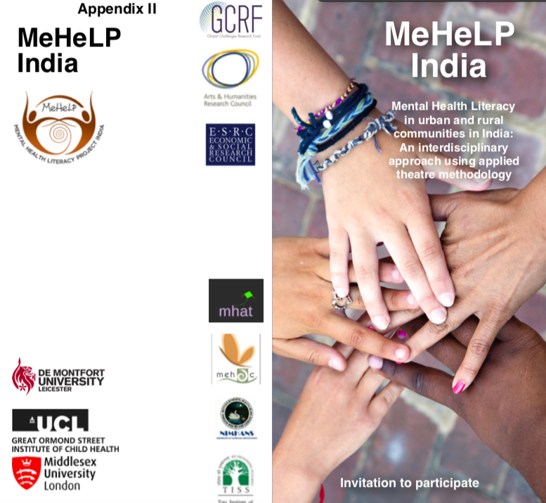
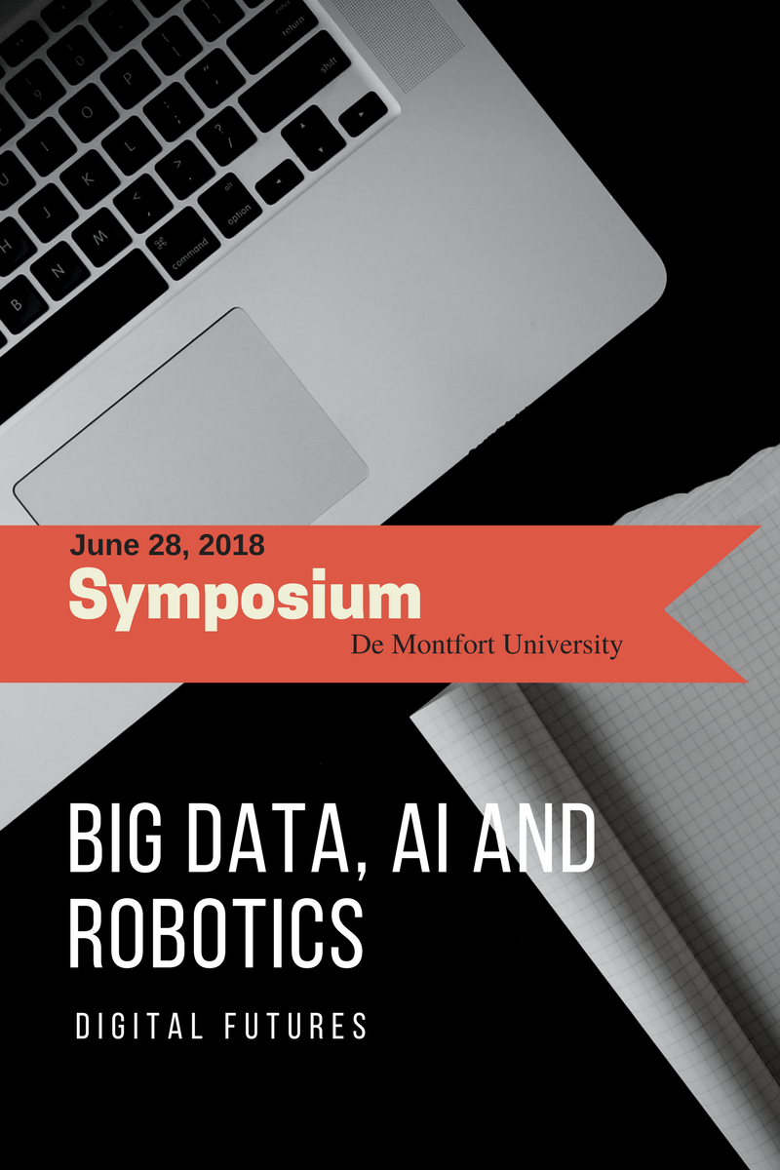
Interdisciplinary research and scholarship: the challenges
Methodological challenges
Pedagogical challenges
Comfort zones
Binary numbers, social sciences and now humanities

Slide 5
Are we living in digital age?
In 2019, it is estimated that there will be around 258.27 million social network users in India, up from close to 168 million in 2016. The most popular social networks in India were YouTube and Facebook, followed by social app WhatsApp. Facebook is projected to reach close to 319 million users in in India by 2021.

Slide 6
Digital India: findings
Digital society and mental health have a complex relationship globally.
According to India Today (2018), “The average suicide rate in India is 10.9 for every lakh people and the majority of people who commit suicide are below 44 years of age”.
WHO report (2016) confirms India to be the most depressed country in the world.
Ian Jack (Guardian, 2018) claimed in an article that India is home to 600 million young people, under the age of 25.
All of these statistics certainly directs us to rethink on the future potential of India’s human and social capital and the inevitable global impact.
Can we aim for IDR?
The tools to empower younger generation

Slide 7
Findings
The increase in internet, social media or digital space use does not necessarily guarantee the population exposed to digital sociality are digitally literate.
Digital sociality like digital literacy can have cultural influences.
Contextualising digital society in a cultural context (Dijk, 2012) is a precondition to understand the digital sociality and media literacy of a nation.
Media exposure. The dissolving boundaries between the public and the private on social media means that the physical, perceptual and psychological exposure to media messages on digital platforms forces us to engage, react or internalise deluge of information, that may critically affect an individual’s emotional state
Forms of self-representation on digital platforms
Sleep-disturbances, anger and straining eyes are some of the health complications affecting youth in India (Masthi, Pruthvi and Phaneendra, 2018).
Is there a need to ‘detox’?
The main question here is whether SMA contributing to social isolation or social digital integration, homogeneity or heterogeneity, unity or fragmentation.

Slide 8
Digital media ecosystem
Step 1 Web
Fragmented informative model
Fading boundaries
Deluge of information
Exposure
Step 2 Social
Framework for participation
Content agnostic
Community features
Step 3 Mobile
Clicktivism
Collective intelligence
Step 4 Search
Recommender system/algorithm
Psychology driven

Slide 9
Maslow’s Hierarchy of needs
Self-Actualisation
Esteem
Love
Safety
Physiological
Self-fulfilment
Psychological
Basic

Slide 10
Digital humans
Siren https://youtu.be/9owTAISsvwk
Meet Mike https://youtu.be/6MIkoLBWRv0
Normalising doctoring
Faking representation
Technology induced personalities created from scratch
Read human emotions, no bad day/bad attitude
“Fourth revolution of humanity”
Digital transformation strategy
Lil Miquela, digital influencer with human following

Slide 11
MeHeLP India
https://drive.google.com/file/d/1DtiEoqKswyemw55kf9UWKuutqE1GY47L/view?ts=5c6e6744
Trailer
https://drive.google.com/file/d/1gvvGTnKhWELHgS9xj11GOLnQrpNVODd9/view?ts=5c6e6721

Slide 12
digital media and society
Strategic communications

Slide 13
Media relations (Digital media relations)
Organisations and individuals want higher and better media profile
Potential to change attitudes of target audience
Potential to improve relationships with the community
Influence government policy at local, national or international level
Improve communications with investors and their advisers
Improve industrial relations
Improve brand image and reputation
Establish brand identity

Slide 14
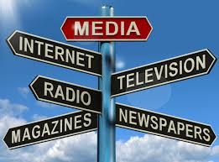
Right media
Specialist press
National press
Regional press
Local press
Broadcast media (radio and TV)
Social and online media
Press release
Feature
Photo story

Slide 15
Developing the media relations
Editor News editor Letters editor Features Editor/programme Producer items Forward planning desks Correspondents Picture editor Reporters/photographers/cameramen/soundmen gathering.
Simplifying message
Content
Preference
Story
Relevance

Slide 16
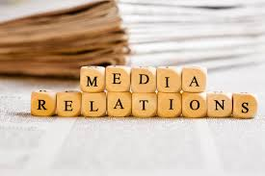
Theoretical relevance (communicating mental health)
Agenda-setting
Framing
Cultivation
Uses Gratification

Slide 17
This is changing the way that newsrooms operate
Single service multiple screens

Slide 18
Integrated newsrooms
Newsrooms are now integrated (print/video/online/community/social media, etc.) as a response to audience fragmentation and real-time environment

Slide 19
Corporate communications
Complex organisations are finding they need more integrated operations to deal with the faster news environment
Creating physical proximity is the first step to better news control (e.g. being active on social media
Reorganisation based on audience needs, not organisational units
Digital comms teams (once separate) are being integrated

Slide 20
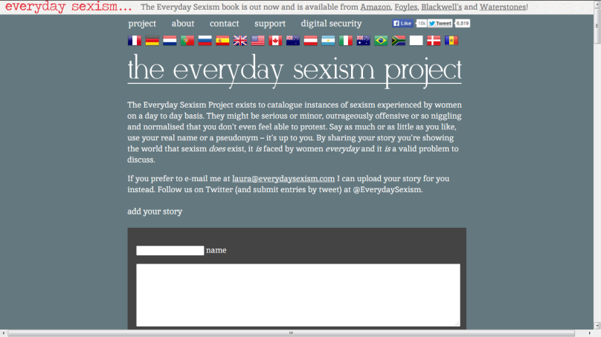
Multimedia not monomedia
Newspapers stop being newspapers and ramp up online capacity
Exclusives now broken on Twitter before they hit the ‘mainstream’ media
New emphasis on visual content
News sourced from multiple locations – often crowdsourced
Community news can have a voice
Rise of the activist – from Kony to Portuguese road safety campaigns

Slide 21
New interactive storytelling
E.g. New York Times ‘Snow Fall’ – combines written narrative with first-hand video accounts, photography, hyperlinks …

Slide 22
We’re talking about ‘Convergence’
“coming together of once-separate media in a digital, networked environment” (Pavlik 2001: 38)
Alternative media and sources i.e. blogger
Declining audiences for newspapers and magazines
Business model in crisis
Gatekeeping/Control of news agendas in decline
Online scrutiny and instant action
Crowds will organise with you, but also against you
More opportunities for direct, unmediated, communications.

Slide 23
Role of social and digital media in strategic communications?

Slide 24
Digital Society (Sociology of digital networks)
“Network society”- structure and power (Castells, 2000a, 2000b, 2012)
“Power is now multidimensional, residing in networks, defining rules and norms of digitally connected societies” (Lupton, 2015)
“Digital technologies ...have played major role in creating a new social structure, global economy and a virtual culture” (Castells, 2000a, 2000b, 2012)
Life is Digital: Back It Up- Digital immortality- http://eterni.me/
http://www.bbc.co.uk/news/business-40935790
http://deadsocial.org/
Notes:
https://www.youtube.com/watch?list=PLbyTsughlOxb039IsSivKOFKTIcbTqSxi&time_continue=87&v=gPoBxSoI3EM
https://www.theguardian.com/commentisfree/2017/dec/03/digital-hippies-integrate-life-and-work-wework-data-firms

Slide 25
Characteristics
Deluge of information and knowledge
Digital things to Digital societies
Ordinary people
Silicon, copper, optical fibre, and wireless infrastructures
Networked Publics

Slide 26
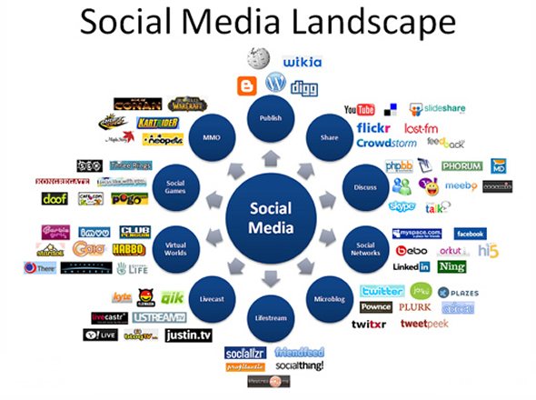
Awkward conversations
Integration
Authenticity
Relevance
Democratised the ability to share thoughts and ideas

Slide 27
Social media
Tools vs.
Broad platforms
User created content
Information and communication ecosystem
Framework for participation
Social Actions
Social Presence
Social Cooperation
Self-representation
Content-agnostic
Community features

Slide 28
What do companies who are ‘good’ on social media do?
Understand the reactive nature of social media
Communicate through the channels that best suit customers/ stakeholders
Deal with ‘unofficial’ fan pages appropriately
Monitor and understand audience before talking to them
Connect rather than just collect likes
Use customer insight
Engage with customers as an equal
Use social media to aggregate sentiment about your brand
Take ‘social’ into your business

Slide 29
Strategic communications plan
What does it look like?

Slide 30
STEP 1: The structure
Introduction/Executive Summary
Set the background - Research the industry and the issues facing it (develop into PEST/EPISTLE analysis); research the internal environmental factors through SWOT (this can be either for your company, campaign or both
Define (i) overall aim and (ii) communication objectives
Define target audiences (and research their communication requirements) Publics, Stakeholder
Define and justify strategy
Define Key messages
Define communication channels
Outline tactics (timeline)
Evaluation (mid-term and end-of-term)

Slide 31
STEP 2: Research
Situation analysis
Environmental scanning – analysing organisational position and identifying key issues
Research into communication channels used by stakeholders
Tools like PESTLE or EPISTLE analysis will help to identify possible opportunities and challenges outside the organisation’s control.
SWOT analysis will then allow the organisation’s strengths and weaknesses to be matched against the opportunities and threats that confront it

Slide 32
Research to consider in the strategic planning process
Facts
Recent industry trends
Characteristics of organisation/brand – what special features does it have – what stories can you tell about it?
Competitors – direct and indirect
Audience facts and issues (and communication channels)
Goals
Organisational objectives – can you identify them?
Role of PR to date – any evidence
Growing/declining - sectors
Target audiences
Desired mindset – what do you want them to think/believe
Preferred communication channels – what do you know? What do you need to find out?
Organisation’s previous experience of reaching these audiences

Slide 33
Step 3: Setting Aims/goals and measurable objectives
Goals/Aims
Aims: overall purpose
Goals- 3types
Reputation management goals Eg. “We aim to improve media relations of our organization significantly within the next year.”
Relationship management goals Eg. “We aim to improve communication with our target audiences during the next six months.”
Task management goals Eg. “Our goal is to increase attendance at our staff ‘exhibition’ for the next one week.”

Slide 34
SMART Objectives
These deliver societal, organisation or stakeholder results. Usually attitudinal or behavioural (Specific, Measurable, Achievable, Realistic, Timely)
Align strategic communication objectives to organisational objectives/aims (if these exist)
Prioritise what is important
“an infinitive verb
a single outcome stated as a receiver of a verb’s action
the magnitude of the action expressed in quantifiable terms
a target date or timeframe for achieving the outcome.”

Slide 35
Measurable objectives?
Specific – Objectives should specify what they want to achieve.
Measurable – You should be able to measure whether you are meeting the objectives or not.
Achievable - Are the objectives you set, achievable and attainable?
Resourced – Can you realistically achieve the objectives with the resources you have?
Timely – When do you want to achieve the set objectives?

Slide 36
What impact/change?
Are these Cognitive (related to thoughts, reflection, awareness), Affective (related to feelings, emotional reaction) or Conative (related to behaviour, actions or change)?
Output and impact objectives
Informational, Attitudinal, Behavioural

Slide 37
Step4: Define and research audiences and stakeholders
Groups prioritised depending on the nature of their stake.
Decide who the focus should be on and the comms strategy to be used
Demographics
Gender
Age
Income
Psychographics
Personality
Attitudes
Values
Language
Behaviour

Slide 38
Step 5. Define and justify strategy – overall intent; the ‘big idea’
Strategy is the overarching ‘how’ you will do something. (‘What’ you will do are tactics)
You can have several strategies
Needs to be justified, e.g …
“A media relations campaign focusing on direct contact with key publications”
“This approach has three distinct benefits which will ultimately lead to increased media coverage.
We increase the frequency of direct communication with journalists, which leads to closer and more fruitful relationships.
We develop reputation on behalf of the client by providing credible and attractive contributions prepared solely for their use.
We are able to keep abreast of issues and topics currently pursued by target publications.”

Slide 39
Step 6: Key messages should be simple
There are two words you're likely to see in any press release or news report about the iPad: "magical" and "revolutionary."
Search: Apple's Secret To Staying On Message - Business Insider http://www.businessinsider.com/apples-secret-to-staying-on-message-2010-4#ixzz2lH7Gu1QW

Slide 40
Message content
A message contains claims that an organisation wants people to believe
But people need evidence/reasons to accept claims
What are we trying to achieve – incremental shifts?
Messages should be based on fact BUT people aren’t rational! - Persuasion and framing play a part
Messages should be measurable
We need different messages for different audiences
May be mediated (by journalists/peers) or used directly
Key messages ARE NOT advertising slogans but can be dropped into press releases, blog posts, presentations, conversations, etc.

Slide 41
Message Mapping activity
Headline
Supporting point
Supporting point
Supporting point
Supporting point

Slide 42
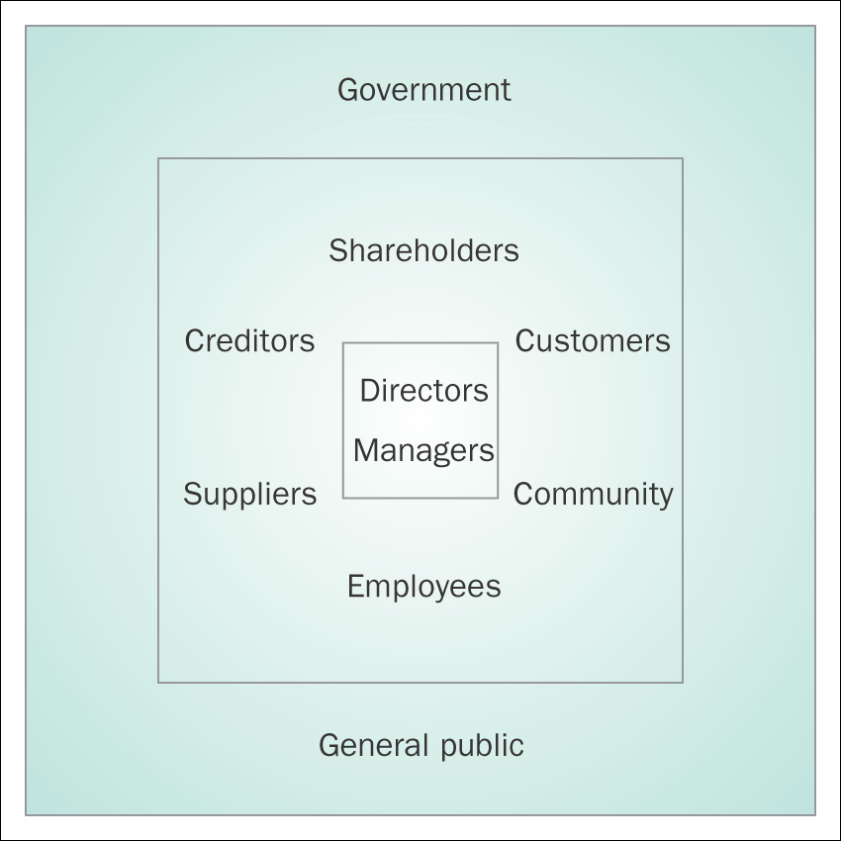
Stakeholders

Slide 43
Applying stakeholder mapping: Power/interest matrix
Level of interest Low High
Low High
Least important
Show consideration
Power
Meet their needs
Key player

Slide 44
Step 7: Communication channels

Slide 45
Step 8: Tactics

Slide 46
Step 9: Evaluation

