Slide 1
Through Vial Impedance Spectroscopy (TVIS)
Dual-electrode System for Process Parameter Determination
Geoff Smith
Leicester School of Pharmacy, De Montfort University, United Kingdom
ISL-FD Midwest Chapter Annual Meeting, April 12th 2018
Midwest Conference Centre, Northlake, IL 60164, USA

Slide 2
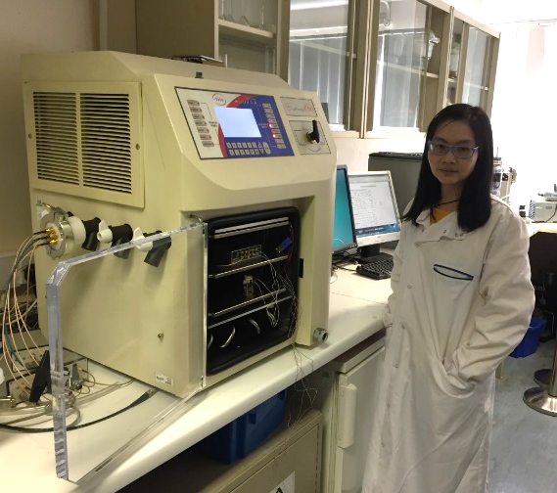
Outline
Description of TVIS measurement system
TVIS dielectric loss mechanisms
First time report on the use of dual-electrode system and its applications
Ice region specific temperature prediction ($T_{i}$, $T_{b}$)
Drying rate determination
Heat transfer coefficient ($K_{v}$) determination
Acknowledgements
Notes:
Change picture for you at freeze-dryer

Slide 3
Through Vial Impedance Spectroscopy (TVIS)
Description of Measurement System

Slide 4
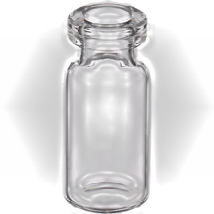
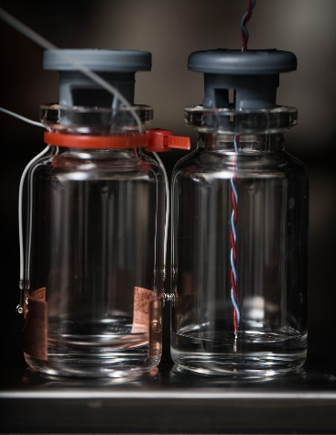
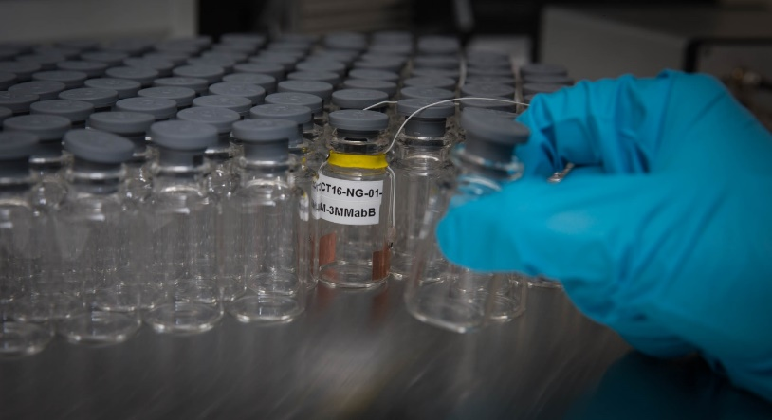
Introduction to the TVIS System
Impedance spectroscopy characterizes the ability of materials to conduct electricity under an applied an oscillating voltage (of varying frequency)
Impedance measurements across a vial rather than within the vial
Hence “Through Vial Impedance Spectroscopy”
Features
Single vial “non-product invasive”
Both freezing and drying characterised in a single technique
Non-perturbing to the packing of vials
Stopper mechanism unaffected
TVIS
SV product temperature
SV sublimation rate
SV end point

Slide 5
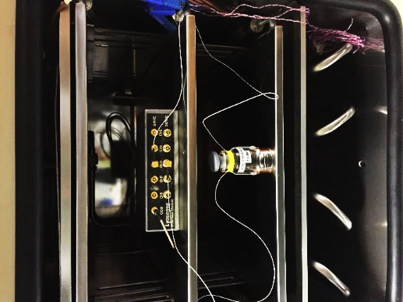
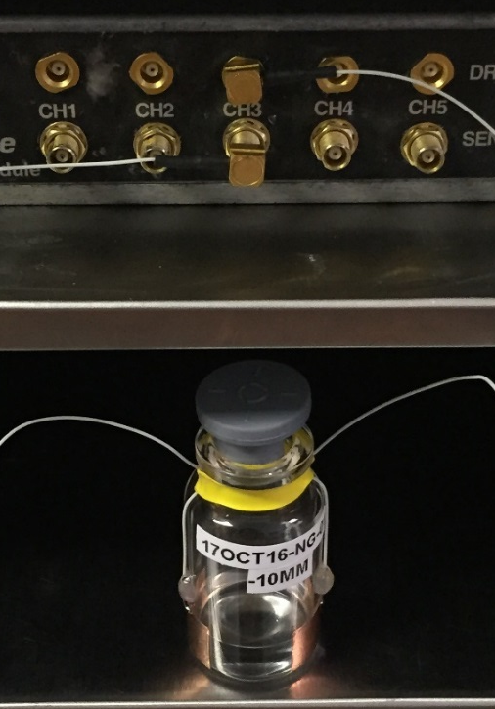
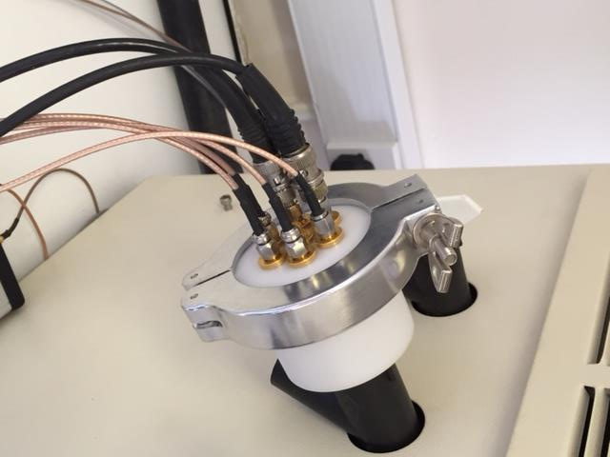
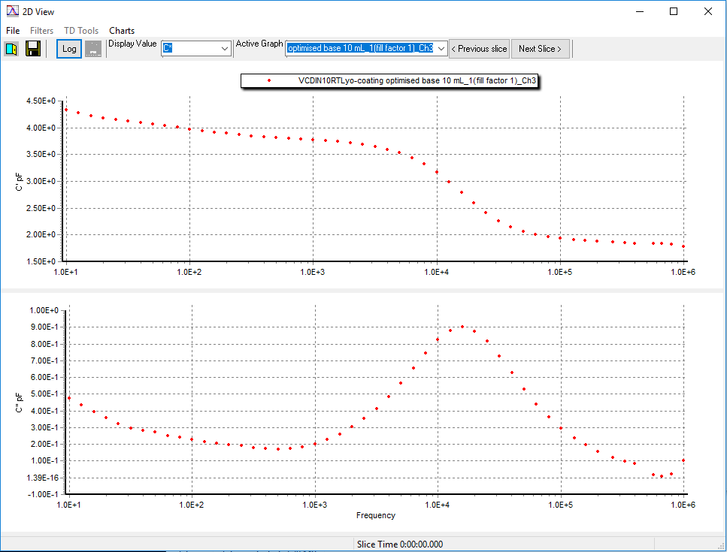
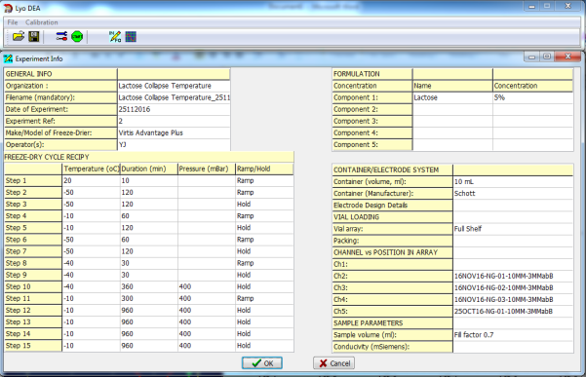
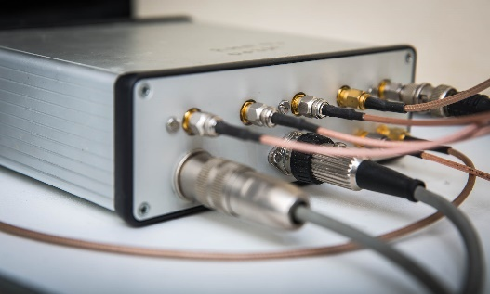
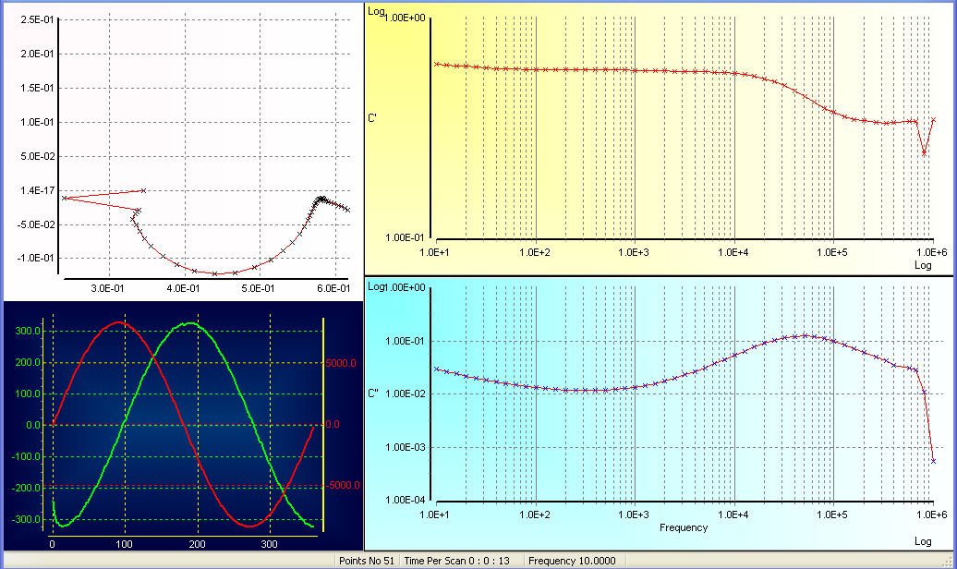
Freeze drying chamber
Junction
box
Pass-through
Resultant current
Stimulating voltage
TVIS
measurement vial
LyoViewTM analysis software
LyoDEATM measurement software
TVIS system
(I to V convertor)
Notes:
Version 14 change : don’t animate first picture – make it appear with the slide
Change photo for the pass-through to the new one
V4 edited slide

Slide 6
Through Vial Impedance Spectroscopy (TVIS)
Dielectric Loss Mechanisms

Slide 7
Glass
1.1
mm
1.1
mm
22
mm
Glass
Measurement vial
+
+
+
+
+
+
+
+
-
-
-
-
-
-
-
-
+
+
+
+
+
+
+
+
-
-
-
-
-
-
-
-
+
+
+
+
+
+
+
+
-
-
-
-
-
-
-
-
10 mm
Electronic polarization distortion of electrons relative to the nuclei
$$E$$
$$E$$
Electronic polarization distortion of electrons relative to the nuclei
-
+
-
+
Atomic polarization distortion of nuclei across a heteroatom bond by stretching and bending
Atomic polarization distortion of nuclei across a heteroatom bond by stretching and bending
-
+
-
+
Instantaneous polarization dominant mechanism in the glass wall
Instantaneous polarization dominant mechanism in the glass wall
TVIS response for empty vial
TVIS response for empty vial

Slide 8
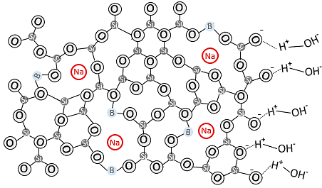
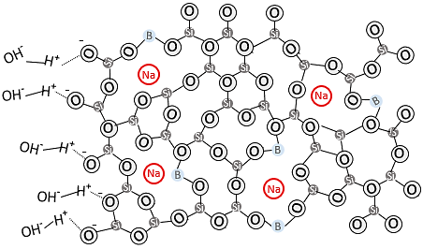
Glass
1.1
mm
1.1
mm
22
mm
Glass
Measurement vial
+
+
+
+
+
+
+
+
-
-
-
-
-
-
-
-
+
+
+
+
+
+
+
+
-
-
-
-
-
-
-
-
+
+
+
+
+
+
+
+
-
-
-
-
-
-
-
-
10 mm
Electronic polarization distortion of electrons relative to the nuclei
$$E$$
MW (space-charge) polarization at glass wall – sample interface
$$E$$
Electronic polarization distortion of electrons relative to the nuclei
-
+
OH−
H⁺
-
+
Atomic polarization distortion of nuclei across a heteroatom bond by stretching and bending
OH−
H⁺
Atomic polarization distortion of nuclei across a heteroatom bond by stretching and bending
OH−
H⁺
-
+
OH−
H⁺
-
+
Instantaneous polarization dominant mechanism in the glass wall
Instantaneous polarization dominant mechanism in the glass wall
Space charge polarization
(weak frequency dependence)
Space charge polarization
(weak frequency dependence)
TVIS response for empty vial
TVIS response for empty vial

Slide 9
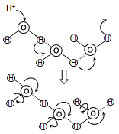
Glass
1.1
mm
1.1
mm
22
mm
Glass
Measurement vial
+
+
+
+
+
+
+
+
-
-
-
-
-
-
-
-
+
+
+
+
+
+
+
+
-
-
-
-
-
-
-
-
+
+
+
+
+
+
+
+
-
-
-
-
-
-
-
-
10 mm
Electronic polarization distortion of electrons relative to the nuclei
$$E$$
$$E$$
Electronic polarization distortion of electrons relative to the nuclei
-
+
OH−
H⁺
-
+
Atomic polarization distortion of nuclei across a heteroatom bond by stretching and bending
OH−
H⁺
Atomic polarization distortion of nuclei across a heteroatom bond by stretching and bending
OH−
OH−
H⁺
H⁺
-
+
OH−
H⁺
-
+
Instantaneous polarization dominant mechanism in the glass wall
Proton-hopping
Conduction of protons in liquid water occurs through the Grotthuss "hop-turn" mechanism
Instantaneous polarization dominant mechanism in the glass wall
Conductivity in pure water
Dipolar polarization
re-orientation/alignment of permanent dipoles in liquid water (Debye-like relaxation)
δ⁻
δ⁺
o
δ⁺
H
H
Space charge polarization
(weak frequency dependence)
$$\overline{P}$$
Space charge polarization
(weak frequency dependence)
Polarization mechanisms in liquid water
(relaxation time, τ ~ 9 ps at 20ºC)
MW (space-charge) polarization at glass wall – sample interface
MW (space-charge) polarization at glass wall – sample interface
TVIS response for empty vial
TVIS response for liquid water
TVIS response for empty vial

Slide 10
Glass
1.1
mm
1.1
mm
22
mm
Glass
Measurement vial
+
+
+
+
+
+
+
+
-
-
-
-
-
-
-
-
+
+
+
+
+
+
+
+
-
-
-
-
-
-
-
-
+
+
+
+
+
+
+
+
-
-
-
-
-
-
-
-
10 mm
Electronic polarization distortion of electrons relative to the nuclei
$$E$$
Dominant at T > 235 K (approx. −40 ºC)
Generation/migration of L- and D- orientation defects
in ice Ih
$$E$$
Electronic polarization distortion of electrons relative to the nuclei
-
+
-
+
Atomic polarization distortion of nuclei across a heteroatom bond by stretching and bending
Atomic polarization distortion of nuclei across a heteroatom bond by stretching and bending
-
+
-
+
Instantaneous polarization dominant mechanism in the glass wall
Dominant at T < 235 K (approx. −40 ºC)
Generation/migration of H3O+/OH− ion pairs (ionic defects) in ice Ih (similar to the Grotthus mechanism)
Instantaneous polarization dominant mechanism in the glass wall
Space charge polarization
(weak frequency dependence)
Polarization mechanism in ice
Space charge polarization
(weak frequency dependence)
MW (space-charge) polarization at glass wall – sample interface
MW (space-charge) polarization at glass wall – sample interface
TVIS response for empty vial
TVIS response for frozen water (ice)
TVIS response for empty vial

Slide 11
Frozen Water and Dielectric Relaxation of Ice
20.3 °C
Real part Capacitance
: The polarization of the water dipole in liquid water at 20 ˚C, with a dielectric loss peak frequency of ~ 18 GHz
-20 °C
-40 °C
(I)
Imaginary part Capacitance
20.3 °C
-20 °C
-40 °C
18 GHz
Notes:
Full Shelf Water Study_281016_Ch4 (Fill factor 0.9) 3mm gap , 400 ubar

Slide 12
Frozen Water and Dielectric Relaxation of Ice
20.3 °C
Real part Capacitance
: The polarization of the water dipole in liquid water at 20 ˚C, with a dielectric loss peak frequency of ~ 18 GHz
: The Maxwell-Wagner (MW) polarization of the glass wall of the TVIS vial at 20 ˚C, with a dielectric loss peak frequency of 17.8 kHz
-20 °C
(II)
-40 °C
(I)
18 kHz
Imaginary part Capacitance
20.3 °C
-20 °C
-40 °C
18 GHz
Notes:
Full Shelf Water Study_281016_Ch4 (Fill factor 0.9) 3mm gap , 400 ubar

Slide 13
Frozen Water and Dielectric Relaxation of Ice
20.3 °C
Real part Capacitance
: The polarization of the water dipole in liquid water at 20 ˚C, with a dielectric loss peak frequency of ~ 18 GHz
: The Maxwell-Wagner (MW) polarization of the glass wall of the TVIS vial at 20 ˚C, with a dielectric loss peak frequency of 17.8 kHz
: The dielectric polarization of ice at −20 ˚C, with a dielectric loss peak frequencies of 2.57 kHz
-20 °C
(II)
-40 °C
(III)
(I)
18 kHz
Imaginary part Capacitance
2.6 kHz
20.3 °C
-20 °C
-40 °C
18 GHz
Notes:
Full Shelf Water Study_281016_Ch4 (Fill factor 0.9) 3mm gap , 400 ubar

Slide 14
Frozen Water and Dielectric Relaxation of Ice
20.3 °C
Real part Capacitance
: The polarization of the water dipole in liquid water at 20 ˚C, with a dielectric loss peak frequency of ~ 18 GHz
: The Maxwell-Wagner (MW) polarization of the glass wall of the TVIS vial at 20 ˚C, with a dielectric loss peak frequency of 17.8 kHz
: The dielectric polarization of ice at −20 ˚C, with a dielectric loss peak frequencies of 2.57 kHz
: The dielectric polarization of ice at −40 ˚C with a dielectric loss peak frequencies of 537 Hz.
-20 °C
(II)
-40 °C
(IV)
(III)
(I)
18 kHz
Imaginary part Capacitance
2.6 kHz
20.3 °C
537 Hz
-20 °C
-40 °C
18 GHz
Notes:
Full Shelf Water Study_281016_Ch4 (Fill factor 0.9) 3mm gap , 400 ubar

Slide 15
Through Vial Impedance Spectroscopy (TVIS)
Applications

Slide 16
Through Vial Impedance Spectroscopy (TVIS)
Monitoring Phase Behaviour (ice nucleation temperature and solidification end points by using $F_{PEAK}$
Liquid State
Solid State
F_{PEAK}
F_{PEAK}
Notes:
Eg temperature cycling below to calibrate Fpeak for temperature (in order to predict product temperatures in primary drying) and the compensate cpeak for temperature so that it can used to monitor ice content and hence drying rate
Eg 2 left graph: monitoring phase behaviour (ice nucleation temperatures and solidufication end points)

Slide 17
Through Vial Impedance Spectroscopy (TVIS)
Monitoring Phase Behaviour (ice nucleation temperature and solidification end points by using $F_{PEAK}$
$F_{PEAK}$temperature calibration for predicting temperature of the product in primary drying
Liquid State
Solid State
-18 ºC
-38 ºC
F_{PEAK}
F_{PEAK}
Notes:
Eg temperature cycling below to calibrate Fpeak for temperature (in order to predict product temperatures in primary drying) and the compensate cpeak for temperature so that it can used to monitor ice content and hence drying rate
Eg 2 left graph: monitoring phase behaviour (ice nucleation temperatures and solidufication end points)

Slide 18
Through Vial Impedance Spectroscopy (TVIS)
Monitoring Phase Behaviour (ice nucleation temperature and solidification end points by using $F_{PEAK}$
$F_{PEAK}$temperature calibration for predicting temperature of the product in primary drying
Surrogate drying rate (from $\frac{dC_{PEAK}^{″}}{dt}$)
Liquid State
Solid State
Drying time
-18 ºC
increase
-38 ºC
F_{PEAK}
F_{PEAK}
Notes:
Eg temperature cycling below to calibrate Fpeak for temperature (in order to predict product temperatures in primary drying) and the compensate cpeak for temperature so that it can used to monitor ice content and hence drying rate
Eg 2 left graph: monitoring phase behaviour (ice nucleation temperatures and solidufication end points)

Slide 19
Through Vial Impedance Spectroscopy (TVIS)
Monitoring Phase Behaviour (ice nucleation temperature and solidification end points by using $F_{PEAK}$
$F_{PEAK}$temperature calibration for predicting temperature of the product in primary drying
Surrogate drying rate (from $\frac{dC_{PEAK}^{″}}{dt}$)
Liquid State
Solid State
Drying time
-18 ºC
increase
-38 ºC
F_{PEAK}
F_{PEAK}
$C^{′}\text{(\sim 100 }\text{kHz}\text{) }$is highly sensitive to low ice volumes; therefore it could be used for determination end point of primary drying
Notes:
Eg temperature cycling below to calibrate Fpeak for temperature (in order to predict product temperatures in primary drying) and the compensate cpeak for temperature so that it can used to monitor ice content and hence drying rate
Eg 2 left graph: monitoring phase behaviour (ice nucleation temperatures and solidufication end points)

Slide 20
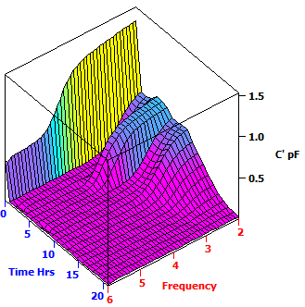
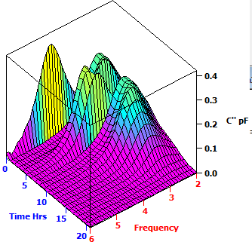
TVIS Response Surface (3D-Plot)
Imaginary Part of Capacitance
Real Part of Capacitance
Annealing = Re-heating and Re-cooling
Liquid state
Frozen solid
Liquid state
Re-heating
Re-heating
Re-cooling
Frozen solid
Re-cooling
Primary drying
Primary drying
low frequency
low frequency
Intermediate frequency
low frequency
High frequency
Notes:
Full Shelf Water Study_010716_Ch1 (Filling volume = 2 mL) touch base electrode

Slide 21
Dielectric loss spectrum
Data analysing software (LyoView ™) identifies the peak frequency ($F_{PEAK}$) and peak amplitude ($C_{PEAK}^{″}$) in the imaginary part of the capacitance spectrum
$$C_{PEAK}^{″}$$
$$F_{PEAK}$$

Slide 22
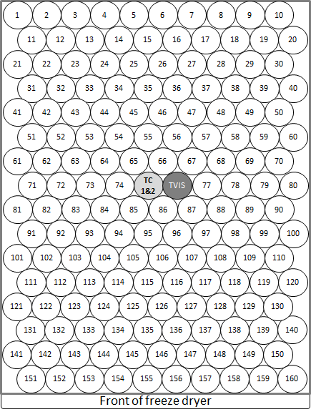
Through Vial Impedance Spectroscopy (TVIS)
Dual-electrode system and its applications
(Ice temperature, Drying rate and Heat transfer coefficient )

Slide 23
Dual-electrode system
Standard TVIS vial
(Single electrode system)
New feature of TVIS vial
(Dual electrode system)
~3.4 g of water $(∅ =0.7)$
~8 g of water $(∅ =0.7)$
Top electrode height ~15 mm
Electrode height ~10 mm
Gap between electrode ~3 mm
Bottom electrode height ~10 mm
Electrode distance from base ~3 mm
Electrode distance from base ~3 mm
Electrode Dimension
10 x 19 mm
Electrode Dimension
Top electrode (TE): 10 x 19 mm
Bottom Electrode (BE): 5 x 19 mm
A dual electrode system comprises two pairs of copper electrode glued to the external surface of a Type I tubular glass vial.
This option is suitable for large volume samples, including those used for $K_{v}$ determination.

Slide 24
Temperature Determination
$T_{\left(F_{PEAK}\right)TE}$ : TVIS predicted temperature
from top electrode (TE)
$T_{\left(F_{PEAK}\right)BE}$ : TVIS predicted temperature
from bottom electrode (BE)
Dual electrode
$$T_{i}$$
15 x 19 mm
$$T_{\left(F_{PEAK}\right)TE}$$
Both $T_{i}$ and $T_{b}$ can be estimated by extrapolating from the temperatures predicted from the centers of top electrode ($T_{\left(F_{PEAK}\right)TE}$) and bottom electrode ($T_{\left(F_{PEAK}\right)BE}$).
3 mm gap
5 x 19 mm
$$T_{\left(F_{PEAK}\right)BE}$$
3 mm gap
$$T_{b}$$

Slide 25
Aims & Objectives
Temperature calibration of log $F_{PEAK}$of top electrode ($T_{\left(F_{PEAK}\right)TE}$) and bottom electrode ($T_{\left(F_{PEAK}\right)BE}$)
I
Prediction ice temperatures for both electrodes during primary drying
II
Temperature calibration of $C_{PEAK}^{″}$
III
Aims
Compensation of $C_{PEAK}^{″}$ during primary drying
IV
To determine the heat transfer coefficient ($K_{v}$) by using a novel dual electrode TVIS approach
Calibration of $C_{PEAK}^{″}$ for ice layer height
V
Estimation of ice layer height during primary drying
VI
Prediction ice temperatures at (i) sublimation interface ($T_{i}$) and (ii) vial’s base ($T_{b}$) including qualification TVIS technique ($T_{i}=T_{\left(P_{i}=P_{c}\right)}$)
VII
Comparison of TVIS drying rate (${∆m}/{∆t}$) with gravimetric method (weight loss)
VIII
Determination (i) the drying rate (${∆m}/{∆t}$) and (ii) ice base temperature ($T_{b}$) during the steady state period
IX
Heat transfer coefficient ($K_{v})$ calculation
X

Slide 26
Objective
Temperature calibration of log $F_{PEAK}$of top electrode ($T_{\left(F_{PEAK}\right)TE}$) and bottom electrode ($T_{\left(F_{PEAK}\right)BE}$)
I
Annealing the sample
In-line TVIS measurement
Identifying peak frequency ($F_{PEAK}$) using LyoView ™ software
Identifying peak frequency (𝐹_𝑃𝐸𝐴𝐾) using LyoView ™ software
Predicting product temperature using calibration plot
Calibration plot (temperature vs Log $F_{PEAK}$)
Calibration plot (temperature vs Log 𝐹_𝑃𝐸𝐴𝐾)

Slide 27
Objective
Temperature calibration of log $F_{PEAK}$of top electrode ($T_{\left(F_{PEAK}\right)TE}$) and bottom electrode ($T_{\left(F_{PEAK}\right)BE}$)
I
Top electrode
-15.5 °C
Shelf Temp.
$$T_{\left(TC\right)1}$$
$$T_{\left(TC\right)2}$$
Bottom electrode
Polynomial coefficient from $Log F_{PEAK}−temperature$calibration
 | $$a$$ | $$b$$ | $$c$$
TE | -1.02 | 30.1 | -114
BE | -5.43 x 10⁻¹ | 26.7 | -109
Top electrode

Slide 28
Objective
Prediction ice temperatures for both electrodes during primary drying
II

Slide 29
Objective
Prediction ice temperatures for both electrodes during primary drying
II
Temp. constant
Temp. constant
Shelf Temperature ${(T}_{s})$
$$T_{\left(TC\right)1}$$
$$T_{\left(F_{PEAK}\right)BE}$$
$$T_{\left(TC\right)2}$$
$$T_{\left(F_{PEAK}\right)TE}$$
$$T_{\left(TC\right)2}$$
$$T_{\left(TC\right)1}$$
$$T_{\left(F_{PEAK}\right)BE}$$
$$T_{(P_{i}=P_{C@270μbar})}=−33.2 ℃$$
$$T_{\left(F_{PEAK}\right)TE}$$
The product temperature predicted by TVIS can demonstrate the temperature gradient across ice cylinder height

Slide 30
Objective
Temperature calibration of $C_{PEAK}^{″}$
III
Annealing the sample
In-line TVIS measurement
Identifying peak amplitude ($C_{PEAK}^{″}$) using LyoView ™ software
Identifying peak amplitude (𝐶_𝑃𝐸𝐴𝐾^″) using LyoView ™ software
Temperature compensation of $C_{PEAK}^{″}$ using calibration plot
Temperature compensation of 𝐶_𝑃𝐸𝐴𝐾^″ using calibration plot
Calibration plot ($C_{PEAK}^{″}$ vs temperature)
Calibration plot (𝐶_𝑃𝐸𝐴𝐾^″ vs temperature)

Slide 31
Objective
Temperature calibration of $C_{PEAK}^{″}$
III
Top electrode
-15.5 °C
Shelf Temp.
$$T_{\left(TC\right)1}$$
$$T_{\left(TC\right)2}$$
Top electrode
-40 °C
-14.5 °C
Polynomial coefficient from $C_{PEAK}^{″}−temperature$calibration
$$a$$ | $$b$$ | $$c$$
-1.00 x 10⁻⁴ | -5.20 x 10⁻³ | 9.19 x 10⁻¹

Slide 32
Objective
Compensation of $C_{PEAK}^{″}$ during primary drying
IV

Slide 33
Objective
Compensation of $C_{PEAK}^{″}$ during primary drying
IV
During primary drying, $C_{PEAK}^{″}$ is attributed to both the loss of ice and product temperature; therefore, it requires a standardization factor ($∅$) for temperature compensation:
The expression for $∅(T)$ can be re-written in terms of the polynomial coefficients (slide 22):
Values of $C_{PEAK}^{″}$ during primary drying are then standardized to the reference temperature by dividing by $∅(T)$ to give a standardized peak amplitude of $Ĉ_{PEAK}^{″}$
$$T_{\left(F_{PEAK}\right)TE}$$
$$∅(T)=\frac{C_{PEAK}^{″}(T)}{C_{PEAK}^{″}(T_{ref})}$$
$C_{PEAK}^{″}(T)$ and $C_{PEAK}^{″}(T_{ref})$ are the peak amplitudes at temperatures ($T$) and reference temperature ($T_{ref}$) during the re-heating ramp. In this presentation, a temperature of -20 °C is used as the reference temperature value
$$C_{PEAK(0)}^{″}0.971 pF$$
$∅(T)$ $=\frac{aT^{2}+bT+c}{a{T_{ref}}^{2}+bT_{ref}+c}$
$$Ĉ_{PEAK(0)}^{″}0.931 pF$$
$$Ĉ_{PEAK(4.9 h)}^{″}0.571 pF$$
$$Ĉ_{PEAK}^{″}=\frac{C_{PEAK}^{″}(T)}{∅(T)}$$
The standardized $C_{PEAK}^{″}$ is defined as $Ĉ_{PEAK}^{″}$

Slide 34
Objective
Calibration of $C_{PEAK}^{″}$ for ice layer height
V
Filling water into TVIS vial
Freezing the sample
In-line TVIS measurement
Calibration plot ($C_{PEAK}^{″}$ vs temperature)
Calibration plot (𝐶_𝑃𝐸𝐴𝐾^″ vs temperature)
Thawing the sample
Identifying $C_{PEAK}^{″}$ using simple peak finding
Identifying 𝐶_𝑃𝐸𝐴𝐾^″ using simple peak finding

Slide 35
Objective
Calibration of $C_{PEAK}^{″}$ for ice layer height
V
15 mm
0 mm

Slide 36
Objective
Estimation of ice layer height during primary drying
VI

Slide 37
Objective
Estimation of ice layer height during primary drying
VI
At -20 °C
Top electrode (TE)
15 X 19 mm
3 mm gap
Bottom electrode (BE)
5 x 19 mm
$$Ice height(h)=9.7485×C_{PEAK}^{″}+1.0462$$
3 mm gap
Freeze Dryer Shelf
Gradient of the line ($m_{h/c}$)
At 2.4 h into primary drying
$Ĉ_{PEAK}^{″}$ = 0.863 pF
Ice height = 9.7485 x 0.863 + 1.0462
= 9.459 mm (from the bottom edge of TE)
Ice front height = 9.459+(2+5+3)
= 19.46 mm
$Ĉ_{PEAK}^{″}$ 0.863 pF
9.46 mm
19.46 mm
3 mm
5 mm
10 mm
2 mm
Freeze drying shelf

Slide 38
Objective
Estimation of ice layer height during primary drying
VI
The dependency of $C_{PEAK}^{″}$ on the ice cylinder height in linear region
Surrogate drying rate can be estimated in terms of decreasing ice height
$h_{(0 h)}$ 20.50 mm
$$y=9.7485x+1.0462$$
$$h_{(4.9 h)} \text{16.68} \text{mm}$$
$$C_{PEAK}^{″}$$
$${Linear gradient (m}_{h/c})$$
$$Ice height \left(h\right)$$

Slide 39
Objective
Prediction ice temperatures at (i) sublimation interface ($T_{i}$) and (ii) vial’s base ($T_{b}$) including qualification TVIS technique ($T_{i}=T_{\left(P_{i}=P_{c}\right)}$)
VII

Slide 40
Objective
Prediction ice temperatures at (i) sublimation interface ($T_{i}$) and (ii) vial’s base ($T_{b}$) including qualification TVIS technique ($T_{i}=T_{\left(P_{i}=P_{c}\right)}$)
VII
At 2.4 h
-30.6 ˚C
$$T_{\left(F_{PEAK}\right)BE}$$
$$T_{\left(F_{PEAK}\right)TE}$$
-32.3 ˚C
$T_{\left(F_{PEAK}\right)TE}$ -32.3 ˚C
19.46 mm
9.46 mm
$T_{\left(F_{PEAK}\right)BE}$ -30.6 ˚C
3 mm
5 mm
0 mm
2 mm
Freeze drying shelf
Ice height 19.46 mm at 2.4 h

Slide 41
Objective
Prediction ice temperatures at (i) sublimation interface ($T_{i}$) and (ii) vial’s base ($T_{b}$) including qualification TVIS technique ($T_{i}=T_{\left(P_{i}=P_{c}\right)}$)
VII
At 2.4 h
-30.6 ˚C
$$T_{\left(F_{PEAK}\right)BE}$$
$$T_{\left(F_{PEAK}\right)TE}$$
-32.3 ˚C
$T_{\left(F_{PEAK}\right)TE}$ -32.3 ˚C
14.73 mm
9.46 mm
$T_{\left(F_{PEAK}\right)BE}$ -30.6 ˚C
3 mm
4.5 mm
5 mm
0 mm
2 mm
Freeze drying shelf
Ice height for${ T}_{\left(F_{PEAK}\right)TE}$ = $2+5+3+$($\frac{9.46}{2}$) = 14.73 mm
Ice height for $T_{\left(F_{PEAK}\right)BE}$ = $2+$($\frac{5}{2}$) = 4.50 mm
Ice height 19.46 mm at 2.4 h

Slide 42
Objective
Prediction ice temperatures at (i) sublimation interface ($T_{i}$) and (ii) vial’s base ($T_{b}$) including qualification TVIS technique ($T_{i}=T_{\left(P_{i}=P_{c}\right)}$)
VII
At 2.4 h
$$h=−5.93×T−176.79$$
-30.6 ˚C
$$T_{\left(F_{PEAK}\right)BE}$$
$$T_{\left(F_{PEAK}\right)TE}$$
-32.3 ˚C
$T_{\left(F_{PEAK}\right)TE}$ -32.3 ˚C
19.46 mm
14.73 mm
9.46 mm
$T_{\left(F_{PEAK}\right)BE}$ -30.6 ˚C
3 mm
4.5 mm
5 mm
0 mm
2 mm
Freeze drying shelf
Ice height for${ T}_{\left(F_{PEAK}\right)TE}$ = $2+5+3+$($\frac{9.46}{2}$) = 14.73 mm
Ice height for $T_{\left(F_{PEAK}\right)BE}$ = $2+$($\frac{5}{2}$) = 4.50 mm
Ice height 19.46 mm at 2.4 h
$$h=−5.93×T−176.79$$
$$T=\frac{h+176.79}{−5.93}$$

Slide 43
Objective
Prediction ice temperatures at (i) sublimation interface ($T_{i}$) and (ii) vial’s base ($T_{b}$) including qualification TVIS technique ($T_{i}=T_{\left(P_{i}=P_{c}\right)}$)
VII
$$T_{b}$$
At 2.4 h
$$h=−5.93×T−176.79$$
-30.6 ˚C
$$T_{\left(F_{PEAK}\right)BE}$$
$$T_{\left(F_{PEAK}\right)TE}$$
-32.3 ˚C
$T_{i}$ -33.1 ˚C
$T_{\left(F_{PEAK}\right)TE}$ -32.3 ˚C
$$T_{i}$$
19.46 mm
14.73 mm
9.46 mm
$T_{\left(F_{PEAK}\right)BE}$ -30.6 ˚C
3 mm
$T_{b}$ -29.8 ˚C
4.5 mm
5 mm
0 mm
2 mm
Freeze drying shelf
Ice height for${ T}_{\left(F_{PEAK}\right)TE}$ = $2+5+3+$($\frac{9.46}{2}$) = 14.73 mm
Ice height for $T_{\left(F_{PEAK}\right)BE}$ = $2+$($\frac{5}{2}$) = 4.50 mm
Ice height 19.46 mm at 2.4 h
$$h=−5.93×T−176.79$$
$$T=\frac{h+176.79}{−5.93}$$
Ice Temperature
At interface ($T_{i}$, 19.46 mm) = $\frac{h+176.79}{−5.93}=\frac{19.46+176.79}{−5.93}$ = -33.1 ˚C
At vial’s base ($T_{b}$, 0 mm) = $\frac{h+176.79}{−5.93}=\frac{0+176.79}{−5.93}$ = -29.8 ˚C

Slide 44
Objective
Prediction ice temperatures at (i) sublimation interface ($T_{i}$) and (ii) vial’s base ($T_{b}$) including qualification TVIS technique ($T_{i}=T_{\left(P_{i}=P_{c}\right)}$)
VII
Temp. constant
($T_{i}$= -33.1± 0.05˚C )
Temp. constant
($T_{i}$= -33.1± 0.05˚C )
Shelf Temperature ${(T}_{s})$
$$T_{b}$$
$$T_{\left(TC\right)1}$$
$$T_{\left(F_{PEAK}\right)BE}$$
$$T_{\left(TC\right)2}$$
$$T_{\left(F_{PEAK}\right)TE}$$
$$T_{i}$$
$$T_{b}$$
$$T_{\left(TC\right)2}$$
$$T_{\left(TC\right)1}$$
$$T_{\left(F_{PEAK}\right)BE}$$
$$T_{(P_{i}=P_{C@270μbar})}=−33.2 ℃$$
$$T_{\left(F_{PEAK}\right)TE}$$
$$T_{i}$$
The product temperature at ice interface predicted by using a 2-points temperature extrapolation close to the temperature of ice vapour at chamber pressure of 270 µbar ($T_{(P_{i}=P_{C@270μbar})}$)

Slide 45
Objective
Comparison of TVIS drying rate (${∆m}/{∆t}$) with gravimetric method (weight loss)
VIII

Slide 46
Objective
Comparison of TVIS drying rate (${∆m}/{∆t}$) with gravimetric method (weight loss)
VIII
Drying rate is based on the assumption of a planar sublimation front
The change in ice cylinder height ($h$) can be equated to the change in ice volume ($v$)
Where $r$is internal radius of vial and $A$ is internal cross section area of vial ($=πr^{2}$)
Ice volume can be converted to ice mass ($m$) by multiplying with ice density ($ρ_{i}$)
Hence; drying rate ($\frac{∆m}{∆t}$) can be expressed by
$$v \left(cylinder\right)=πr^{2}h=Ah$$
$$m =ρ_{i}∙πr^{2}h=ρ_{i}∙Ah$$
$$Drying rate (\frac{∆m}{∆t})=ρ_{i}∙A∙\frac{h_{\left(t1\right)}−h_{(t2)}}{t_{2}−t_{1}}$$

Slide 47
Objective
Comparison of TVIS drying rate (${∆m}/{∆t}$) with gravimetric method (weight loss)
VIII
An average surrogate drying rate calculation
Ice density ${(ρ}_{i} )$at -32 ˚C = 0.920 g⋅cm⁻³
Internal vial diameter (VC010-20C) = 2.21 cm Cross-section area ($A$) = 3.80 cm²
Ice height at 0 h ($h_{(0 h)}$) = 20.50 mm
Ice height at 4.9 h ($h_{(4.9 h)})$ = 16.68 mm
$h_{(0 h)}$ 20.50 mm
$$Drying rate (\frac{∆m}{∆t})=ρ_{i}∙A∙\frac{h_{(t1)}−h_{(t2)}}{t_{2}−t_{1}}$$
$$h_{(4.9 h)} \text{16.68} \text{mm}$$
$$Drying rate =0.920 g∙{cm}^{−3}×3.80 {cm}^{2}×\frac{\left(20.50−16.68\right)×{10}^{−1}cm}{\left(4.9−0\right)h}$$
$=0.27 g∙h^{−1}$
 | $$Drying rate$$
$$TVIS$$ | 0.27 g/h
$$Gravimetric$$ | 0.25 g/h

Slide 48
Objective
Determination (i) the drying rate (${∆m}/{∆t}$) and (ii) ice base temperature ($T_{b}$) during the steady state period
IX

Slide 49
Objective
Determination (i) the drying rate (${∆m}/{∆t}$) and (ii) ice base temperature ($T_{b}$) during the steady state period for heat transfer coefficient ($K_{v})$ calculation
IX
$$T_{b}$$
$$T_{i}$$

Slide 50
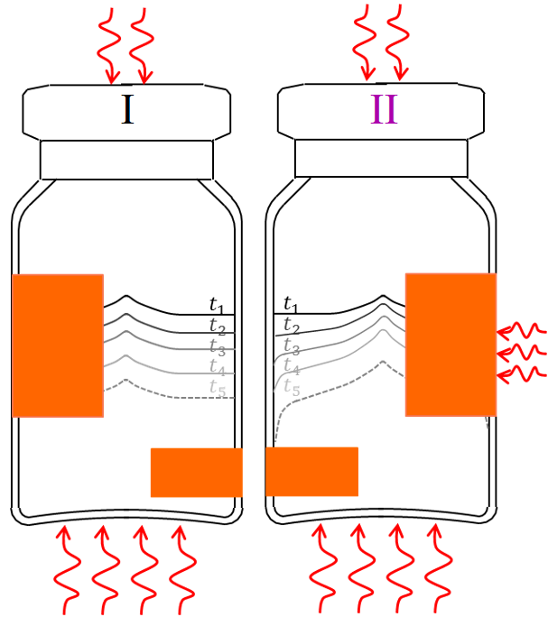
Objective
Determination (i) the drying rate (${∆m}/{∆t}$) and (ii) ice base temperature ($T_{b}$) during the steady state period for heat transfer coefficient ($K_{v})$ calculation
IX
I
II
$$T_{b}$$
$T_{avg}$ ~32 ˚C
$$T_{i}$$
Temp. constant $T_{i}$= -33.1± 0.05˚C
$T_{b}$= -29.8± 0.03˚C

Slide 51
Objective
Determination (i) the drying rate (${∆m}/{∆t}$) and (ii) ice base temperature ($T_{b}$) during the steady state period for heat transfer coefficient ($K_{v})$ calculation
IX
$$T_{b}$$
$T_{avg}$ ~32 ˚C
$$T_{i}$$
Drying rate during the steady state
Temp. constant $T_{i}$= -33.1± 0.05˚C
$T_{b}$= -29.8± 0.03˚C
$$Drying rate (\frac{∆m}{∆t})=ρ_{i}∙A∙\frac{h_{(t1)}−h_{(t2)}}{t_{2}−t_{1}}$$

Slide 52
Objective
Determination (i) the drying rate (${∆m}/{∆t}$) and (ii) ice base temperature ($T_{b}$) during the steady state period for heat transfer coefficient ($K_{v})$ calculation
IX
$$T_{b}$$
$T_{avg}$ ~32 ˚C
$$T_{i}$$
Drying rate during the steady state
Ice density ${(ρ}_{i} )$ at -32˚C = 0.920 g⋅cm⁻³
(Calculated ice temperature between $T_{i} \&{ T}_{b}\text{)}$
Temp. constant $T_{i}$= -33.1± 0.05˚C
$T_{b}$= -29.8± 0.03˚C
$$Drying rate (\frac{∆m}{∆t})=ρ_{i}∙A∙\frac{h_{(t1)}−h_{(t2)}}{t_{2}−t_{1}}$$

Slide 53
Objective
Determination (i) the drying rate (${∆m}/{∆t}$) and (ii) ice base temperature ($T_{b}$) during the steady state period for heat transfer coefficient ($K_{v})$ calculation
IX
$$T_{b}$$
$T_{avg}$ ~31.5 ˚C
$$T_{i}$$
Drying rate during the steady state
Ice density ${(ρ}_{i} )$ at -32˚C = 0.920 g⋅cm⁻³
(Calculated ice temperature between $T_{i} \&{ T}_{b}\text{)}$
Internal vial diameter (VC010-20C) = 2.21 cm
Temp. constant $T_{i}$= -33.1± 0.05˚C
$T_{b}$= -29.8± 0.03˚C
$$Drying rate (\frac{∆m}{∆t})=ρ_{i}∙A∙\frac{h_{(t1)}−h_{(t2)}}{t_{2}−t_{1}}$$

Slide 54
Objective
Determination (i) the drying rate (${∆m}/{∆t}$) and (ii) ice base temperature ($T_{b}$) during the steady state period for heat transfer coefficient ($K_{v})$ calculation
IX
$$T_{b}$$
$T_{avg}$ ~31.5 ˚C
$$T_{i}$$
Drying rate during the steady state
Ice density ${(ρ}_{i} )$ at -32˚C = 0.920 g⋅cm⁻³
(Calculated ice temperature between $T_{i} \&{ T}_{b}\text{)}$
Internal vial diameter (VC010-20C) = 2.21 cm Cross-section area ($A$) = 3.80 cm²
Temp. constant $T_{i}$= -33.1± 0.05˚C
$T_{b}$= -29.8± 0.03˚C
$$Drying rate (\frac{∆m}{∆t})=ρ_{i}∙A∙\frac{h_{(t1)}−h_{(t2)}}{t_{2}−t_{1}}$$

Slide 55
Objective
Determination (i) the drying rate (${∆m}/{∆t}$) and (ii) ice base temperature ($T_{b}$) during the steady state period for heat transfer coefficient ($K_{v})$ calculation
IX
$$T_{b}$$
$T_{avg}$ ~31.5 ˚C
$$T_{i}$$
Drying rate during the steady state
Ice density ${(ρ}_{i} )$ at -32˚C = 0.920 g⋅cm⁻³
(Calculated ice temperature between $T_{i} \&{ T}_{b}\text{)}$
Internal vial diameter (VC010-20C) = 2.21 cm Cross-section area ($A$) = 3.80 cm²
Ice height at 2 h ($h_{(2 h)}$) = 19.94 mm
Temp. constant $T_{i}$= -33.1± 0.05˚C
$T_{b}$= -29.8± 0.03˚C
$$Drying rate (\frac{∆m}{∆t})=ρ_{i}∙A∙\frac{h_{(t1)}−h_{(t2)}}{t_{2}−t_{1}}$$
$h_{(2 h)}$ 19.94 mm

Slide 56
Objective
Determination (i) the drying rate (${∆m}/{∆t}$) and (ii) ice base temperature ($T_{b}$) during the steady state period for heat transfer coefficient ($K_{v})$ calculation
IX
$$T_{b}$$
$T_{avg}$ ~31.5 ˚C
$$T_{i}$$
Drying rate during the steady state
Ice density ${(ρ}_{i} )$ at -32˚C = 0.920 g⋅cm⁻³
(Calculated ice temperature between $T_{i} \&{ T}_{b}\text{)}$
Internal vial diameter (VC010-20C) = 2.21 cm Cross-section area ($A$) = 3.80 cm²
Ice height at 2 h ($h_{(2 h)}$) = 19.94 mm
Ice height at 2.8 h ($h_{(2.8 h)})$ = 18.98 mm
Temp. constant $T_{i}$= -33.1± 0.05˚C
$T_{b}$= -29.8± 0.03˚C
$$Drying rate (\frac{∆m}{∆t})=ρ_{i}∙A∙\frac{h_{(t1)}−h_{(t2)}}{t_{2}−t_{1}}$$
$h_{(2 h)}$ 19.94 mm
$$h_{(2.8 h)} \text{1}\text{8.9}\text{8} \text{mm}$$

Slide 57
Objective
Determination (i) the drying rate (${∆m}/{∆t}$) and (ii) ice base temperature ($T_{b}$) during the steady state period for heat transfer coefficient ($K_{v})$ calculation
IX
$$T_{b}$$
$T_{avg}$ ~31.5 ˚C
$$T_{i}$$
Drying rate during the steady state
Ice density ${(ρ}_{i} )$ at -32˚C = 0.920 g⋅cm⁻³
(Calculated ice temperature between $T_{i} \&{ T}_{b}\text{)}$
Internal vial diameter (VC010-20C) = 2.21 cm Cross-section area ($A$) = 3.80 cm²
Ice height at 2 h ($h_{(2 h)}$) = 19.94 mm
Ice height at 2.8 h ($h_{(2.8 h)})$ = 18.98 mm
Temp. constant $T_{i}$= -33.1± 0.05˚C
$T_{b}$= -29.8± 0.03˚C
$$Drying rate (\frac{∆m}{∆t})=ρ_{i}∙A∙\frac{h_{(t1)}−h_{(t2)}}{t_{2}−t_{1}}$$
$h_{(2 h)}$ 19.94 mm
$$h_{(2.8 h)} \text{1}\text{8.9}\text{8} \text{mm}$$
$$Drying rate =0.920 g∙{cm}^{−3}×3.80 {cm}^{2}×\frac{\left(19.94−18.98\right)×{10}^{−1}cm}{\left(2.8−2.0\right) h}$$
$$=0.42 g∙h^{−1}$$

Slide 58
Objective
Determination (i) the drying rate (${∆m}/{∆t}$) and (ii) ice base temperature ($T_{b}$) during the steady state period for heat transfer coefficient ($K_{v})$ calculation
IX
$$T_{b}$$
$T_{avg}$ ~32 ˚C
$$T_{i}$$
Drying rate during the steady state
Ice density ${(ρ}_{i} )$ at -32˚C = 0.920 g⋅cm⁻³
(Calculated ice temperature between $T_{i} \&{ T}_{b}\text{)}$
Internal vial diameter (VC010-20C) = 2.21 cm Cross-section area ($A$) = 3.80 cm²
Ice height at 2 h ($h_{(2 h)}$) = 19.94 mm
Ice height at 2.8 h ($h_{(2.8 h)})$ = 18.98 mm
Temp. constant $T_{i}$= -33.1± 0.05˚C
$T_{b}$= -29.8± 0.03˚C
$$Drying rate (\frac{∆m}{∆t})=ρ_{i}∙A∙\frac{h_{(t1)}−h_{(t2)}}{t_{2}−t_{1}}$$
$h_{(2 h)}$ 19.94 mm
$$h_{(2.8 h)} \text{1}\text{8.9}\text{8} \text{mm}$$
TVIS parameters used for determination:
$\frac{∆m}{∆t}$ = 0.42 g·h⁻¹
$T_{b}$= -29.8˚C
$$Drying rate =0.920 g∙{cm}^{−3}×3.80 {cm}^{2}×\frac{\left(19.94−18.98\right)×{10}^{−1}cm}{\left(2.8−2.0\right) h}$$
$$=0.42 g∙h^{−1}$$

Slide 59
Objective
Heat transfer coefficient ($K_{v})$ calculation
X

Slide 60
Objective
Heat transfer coefficient ($K_{v})$ calculation
X
Parameters | TVIS
Drying rate at steady state (g/h) (2-2.8 h into primary drying) | 0.42
Shelf Temperature, $T_{s}$ (K) | 273.3
Vial’s base Temperature, $T_{b}$(K) | 243.3
Notes:
Freezing -40 C
Annealing -10 C
Drying -20 C

Slide 61
Objective
Heat transfer coefficient ($K_{v})$ calculation
X
Parameters | TVIS
Drying rate at steady state (g/h) (2-2.8 h into primary drying) | 0.42
Shelf Temperature, $T_{s}$ (K) | 273.3
Vial’s base Temperature, $T_{b}$(K) | 243.3
$$L\frac{∆m}{∆t}=A_{e}K_{v}(T_{s}−T_{b})$$
$$K_{v}=\frac{L\frac{∆m}{∆t}}{A_{e}(T_{s}−T_{b})}$$
$L$ is the latent heat of sublimation of ice (2844 J⋅g⁻¹ or 679.7 cal ⋅g⁻¹) and $A_{e}$is external cross-sectional area of the base of the TVIS vial (4.62 cm²)
Notes:
Freezing -40 C
Annealing -10 C
Drying -20 C

Slide 62
Objective
Heat transfer coefficient ($K_{v})$ calculation
X
Parameters | TVIS
Drying rate at steady state (g/h) (2-2.8 h into primary drying) | 0.42
Shelf Temperature, $T_{s}$ (K) | 273.3
Vial’s base Temperature, $T_{b}$(K) | 243.3
$$L\frac{∆m}{∆t}=A_{e}K_{v}(T_{s}−T_{b})$$
$$K_{v}=\frac{L\frac{∆m}{∆t}}{A_{e}(T_{s}−T_{b})}$$
$$K_{v}(270 μbar)=\frac{L\frac{∆m}{∆t}}{A_{e}(T_{s}−T_{b})}$$
$$=\frac{679.7 cal∙g^{−1}×0.42 g∙h^{−1}}{4.62 {cm}^{2}×\left(273.3−243.3\right)K}$$
$L$ is the latent heat of sublimation of ice (2844 J⋅g⁻¹ or 679.7 cal ⋅g⁻¹) and $A_{e}$is external cross-sectional area of the base of the TVIS vial (4.62 cm²)
$$=2.06 cal∙h^{−1}∙{cm}^{−2}∙K^{−1}$$
$$=5.73×{10}^{−4}cal∙s^{−1}∙{cm}^{−2}∙K^{−1}$$
$$K_{v}(270 μbar)=5.73×{10}^{−4}cal∙s^{−1}∙{cm}^{−2}∙K^{−1}$$
Notes:
Freezing -40 C
Annealing -10 C
Drying -20 C

Slide 63
Objective
Heat transfer coefficient ($K_{v})$ calculation
X
Parameters | TVIS
Drying rate at steady state (g/h) (2-2.8 h into primary drying) | 0.42
Shelf Temperature, $T_{s}$ (K) | 273.3
Vial’s base Temperature, $T_{b}$(K) | 243.3
$K_{v}($TVIS @ 270 μbar)
5.73 x 10⁻⁴
$$L\frac{∆m}{∆t}=A_{e}K_{v}(T_{s}−T_{b})$$
$$K_{v}=\frac{L\frac{∆m}{∆t}}{A_{e}(T_{s}−T_{b})}$$
$$K_{v}(270 μbar)=\frac{L\frac{∆m}{∆t}}{A_{e}(T_{s}−T_{b})}$$
$$=\frac{679.7 cal∙g^{−1}×0.42 g∙h^{−1}}{4.62 {cm}^{2}×\left(273.3−243.3\right)K}$$
$L$ is the latent heat of sublimation of ice (2844 J⋅g⁻¹ or 679.7 cal ⋅g⁻¹) and $A_{e}$is external cross-sectional area of the base of the TVIS vial (4.62 cm²)
$$=2.06 cal∙h^{−1}∙{cm}^{−2}∙K^{−1}$$
$$=5.73×{10}^{−4}cal∙s^{−1}∙{cm}^{−2}∙K^{−1}$$
$$K_{v}(270 μbar)=5.73×{10}^{−4}cal∙s^{−1}∙{cm}^{−2}∙K^{−1}$$
Notes:
Freezing -40 C
Annealing -10 C
Drying -20 C

Slide 64
Additional comments
1) Calculation the relative heat transfer from the vial’s base
2) Qualification of steady state heat transfer mechanisms

Slide 65
--29.8 ˚C
$$T_{b}$$
Parameters | TVIS
Ice interfacial temperature, $T_{i}$ (K) | 240.1
Vial’s base Temperature, $T_{b}$ (K) | 243.3
Ice height or thickness of material, $d$ (m) | 0.0195
Average temperature (between $T_{i}$ & $T_{b})$, $T_{avg}$ (˚C) | -31.5
$∆T$(between $T_{i}$ & $T_{b})$ (K) | 3.3
$$T_{\left(F_{PEAK}\right)BE}$$
$$T_{\left(F_{PEAK}\right)TE}$$
$$T_{i}$$
--33.1 ˚C
Ice height 19.46 mm at 2.4 h

Slide 66
Objective
y = 4E-07x³ + 0.0001x² - 0.0069x + 2.2174
Parameters | TVIS
Ice interfacial temperature, $T_{i}$ (K) | 240.1
Vial’s base Temperature, $T_{b}$ (K) | 243.3
Ice height or thickness of material, $d$ (m) | 0.0195
Average temperature (between $T_{i}$ & $T_{b})$, $T_{avg}$ (˚C) | -31.5
$∆T$(between $T_{i}$ & $T_{b})$ (K) | 3.3
Thermal conductivity of ice
$T_{avg}$ of -31.5 ˚C = 2.52 W/mK
Or 2.52 J/smK
$$Drying rate (\frac{∆m}{∆t})=\frac{kA∆T}{Ld}$$
$$\frac{∆m}{∆t}=\frac{2.52 W∙m^{−1}K^{−1}×0.00038 m^{2}×3.3 K}{2844 ×0.0195}$$
k is the thermal conductivity constant for the material
A is the cross sectional area of the material transferring heat (≡ internal cross-sectional area of vial) 0.00038 m²
ΔT is the difference in temperature between one side of the material and the other
$L$ is Latent heat of sublimation at 240 K (2844 J/g)
d is the thickness of the material (≡ ice height)
$$=\frac{2.52 J∙{s^{−1}m}^{−1}K^{−1}×0.00038 m^{2}×3.3 K}{2844 J∙g^{−1}×0.0195 m}$$
$=5.74 ×{10}^{−5} g/s$
$$=0.207 g/h$$
This drying rate is 50% of drying rate calculated by TVIS
Notes:
1 Watt = 1 Joule/sec
Watts/(meter∗Kelvin)

Slide 67
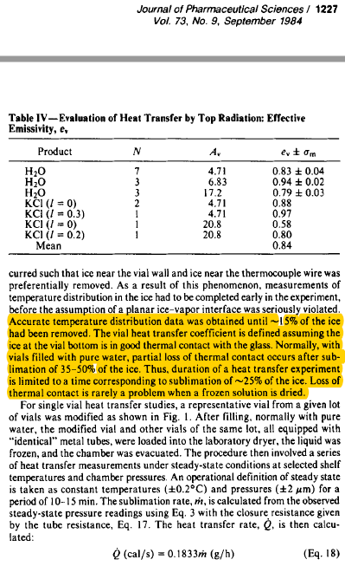
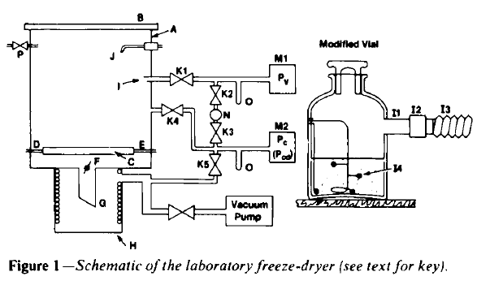
A single vial technique Pikal, et al. (1984)
The mean sublimation rate was calculated from the mass of ice sublimed and the time required for sublimation.
Notes:
[1] M. Pikal, M. Roy, S. Shah, Mass and heat transfer in vial freeze‐drying of pharmaceuticals: Role of the vial, J. Pharm. Sci. 73 (1984) 1224-1237.
[2] S. Hibler, C. Wagner, H. Gieseler, Vial freeze-drying, part 1: New insights into heat transfer characteristics of tubing and molded vials, J. Pharm. Sci. 101 (2012) 1189-1201.
[3] B. Scutella, S. Passot, E. Bourles, F. Fonseca, I.C. Trelea, How Vial Geometry Variability Influences Heat Transfer and Product Temperature During Freeze-Drying, J. Pharm. Sci. 106 (2017) 770-778.

Slide 68
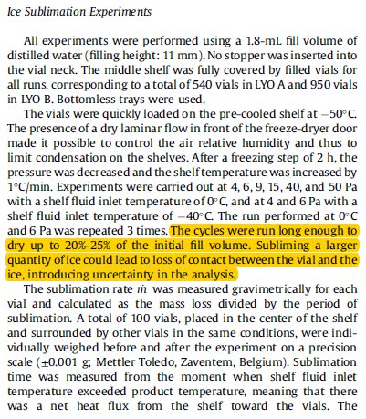
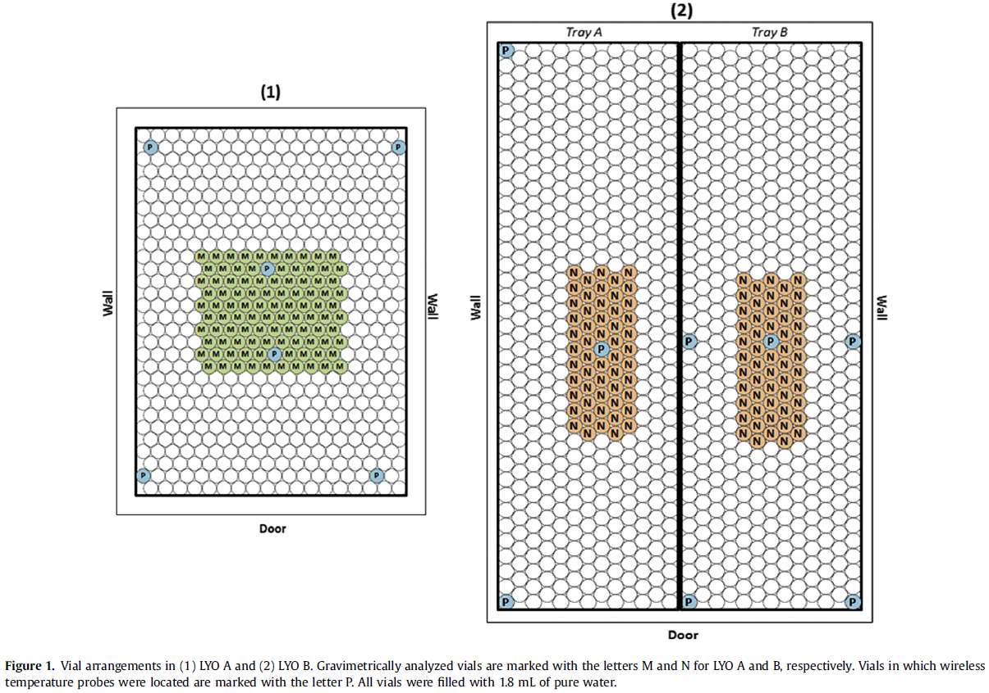
A single vial technique Scutella, et al. 2017
Notes:
[1] M. Pikal, M. Roy, S. Shah, Mass and heat transfer in vial freeze‐drying of pharmaceuticals: Role of the vial, J. Pharm. Sci. 73 (1984) 1224-1237.
[2] S. Hibler, C. Wagner, H. Gieseler, Vial freeze-drying, part 1: New insights into heat transfer characteristics of tubing and molded vials, J. Pharm. Sci. 101 (2012) 1189-1201.
[3] B. Scutella, S. Passot, E. Bourles, F. Fonseca, I.C. Trelea, How Vial Geometry Variability Influences Heat Transfer and Product Temperature During Freeze-Drying, J. Pharm. Sci. 106 (2017) 770-778.

Slide 69
Assumption for $K_{v}$ determination
How do we know the heat transfer mechanisms constant up to 25% loss of ice mass?
If the heat transfer mechanisms change because of ice- glass interface contact or because of the change of ice shape (surface area), then surely heat transfer coefficient will change.
It requires the technique to qualify when the heat transfer mechanisms change

Slide 70
Limitation of TVIS Systems
10% decrease
Glass wall impedance can increase the peak frequency ($F_{PEAK}$) but reduce the peak amplitude ($C_{PEAK}^{″}$)
Decrease in $F_{PEAK}$ during primary drying is due to loss of contact of ice with the side wall
Notes:
Could you have a look at book chapter version 50 that we reviewed on friday and recreate the fig (that was in Zview) which shows the fit result to frozen water (Cg=CPE-DE=Cs). Then remove Cg=CPE and simulate the model keeping the fit result estimates for DE and Cs
That will show how the glass wall impedance increases the peak frequency but reduces the peak height
Then go back to the full model and make a 10% reduction in Cg (from 6.561E-13 to 5.9049E-13 )to and stimulate the full model to see of the peak shifts to lower frequency
Hopefully that will then allow us to qualify that the decrease in Fpeak during primary drying is due to loss of contact of ice with the side wall
When the ice loses contact then the heat transfer mechanism will change and so will Kv

Slide 71
I
II
$$T_{b}$$
$T_{avg}$ ~32 ˚C
$$T_{i}$$
Temp. constant $T_{i}$= -33.1± 0.05˚C
$T_{b}$= -29.8± 0.03˚C

Slide 72
Discussion
Decrease in $F_{PEAK}$ suggests that the temperature may be decreasing after the steady state period, contrary to accepted knowledge that the temperature starts to increase owing to a reduction in drying rate and hence the degree of self cooling
Decrease in $F_{PEAK}$ is more likely to be due to a change in the ice-glass contact associated with a change in the shape of the ice cylinder.
Conclusion
The period for determining the drying rate should be decreased from 25% ice loss to 10% suggested by our experiment.

Slide 73
Limitations
$C_{PEAK}^{″}$and $F_{PEAK}$parameters rely on intimate contact of ice cylinder with glass wall
$C^{′}$(100 kHz) parameter does not dependent on contact and can be used for end point but relationship between $C^{′}$(100 kHz) ice constant is non-linear
Cable length limited to 1m at present
C-TVIS not compatible with front loading system
Incompatible with TCs in same TVIS vial (use fibre optic sensors – INFAP)

Slide 74
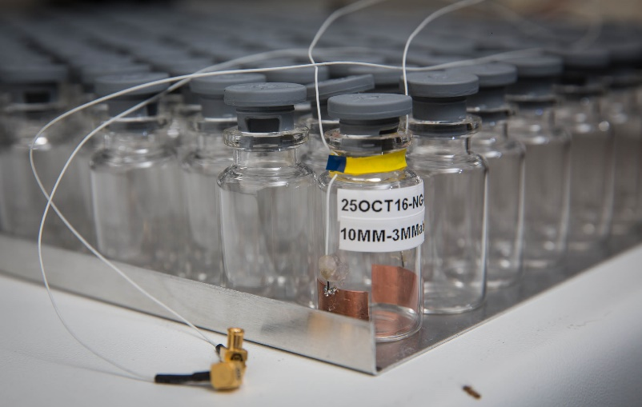
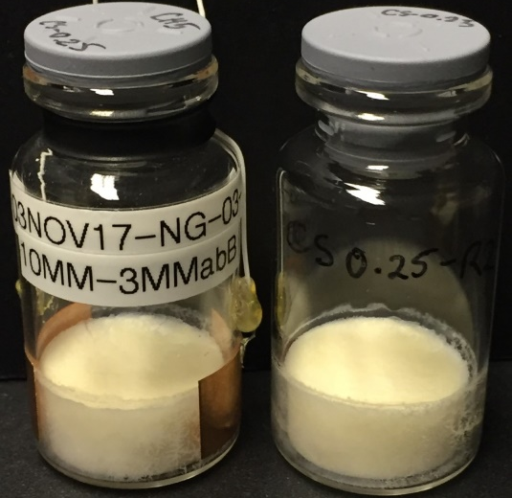
Future Work
Development mapping a drying characteristics
heat transfer coefficients ($K_{V}$)
dry layer resistance ($R_{P}$)
Instrument Development
Commercial C-TVIS (2018)
Non-contact TVIS (2018-19)
Micro-well screening
Vial clusters in batch FD
TVIS - Shuttle (2019-20)
Non-invasive real time information for characterising the freeze drying

Slide 75
Acknowledgements, Recent Projects & Collaborators
De Montfort University, School of Pharmacy
Evgeny Polygalov: co-inventor of TVIS instrument
Yowwares Jeeraruangrattana. PhD student
Bhaskar Pandya. PhD student
Irina Ermolina. Senior Lecturer
LyoDEA
Lyophilization process analytics
By dielectric analysis
Government Support for industry
Biopharmaceutical Stability at
Room Temperature
Analytical Technologies for the
Stabilization of Biopharmaceuticals

Slide 76
Acknowledgements, Recent Projects & Collaborators
De Montfort University
Evgeny Polygalov. Senior Research Fellow
Irina Ermolina. Senior Lecturer
Yowwares Jeerarunangrattana. PhD student
Bhaskar Pandya. PhD student
GEA Process Engineering
Trevor Page & Julian Taylor
Daniela Buchmeyer & Thomas Beutler
BlueFrog : Chris Samwell Ben Irvin
NIBSC : Paul Matejtschuk
Sanofi : Tim McCoy

Slide 77
Thank you

Slide 78
Objective
TVIS temperature calibration of log $F_{PEAK}$of top electrode ($T_{\left(F_{PEAK}\right)TE}$) and bottom electrode ($T_{\left(F_{PEAK}\right)BE}$)
I

Slide 79
Objective
Calibration $C_{PEAK}^{″}$ by accounting for the temperature dependency of $C_{PEAK}^{″}$
II

Slide 80
Objective
Development method for temperature compensation of $C_{PEAK}^{″}$ during primary drying
III

Slide 81
Objective
Prediction of ice temperatures at (i) interface ($T_{i}$) and (ii) base ($T_{b}$) including qualification TVIS technique ($T_{i}=T_{\left(P_{i}=P_{c}\right)}$)
IV

Slide 82
Objective
Estimation the surrogate drying rate (${∆m}/{∆t}$) and evaluation TVIS determination with gravimetric method (weight loss)
V

Slide 83
Objective
Determination (i) the drying rate (${∆m}/{∆t}$) and (ii) ice base temperature ($T_{b}$) during the steady state period for heat transfer coefficient ($K_{v})$ calculation
VI

Slide 84
0 mm
0 mm
0 mm
Freeze drying shelf
Freeze drying shelf
Freeze drying shelf
Filling water into TVIS vial up to bottom edge of top electrode (≡ 0 mm)
Freezing water at -20°C for 3 hours
Thawing ice at 5°C for 3 hours
Repeat this process until the ice height reaches top edge of top electrode (15 mm)
~0.92 mm
~13.8 mm
Freeze drying shelf
An aliquot part (0.35 g) of water corresponding to ice height 1 mm is added into TVIS vial
Freeze drying shelf
Notes:
*An aliquot part for Ice is calculated based on ice density of 0.9194 g/mL at -20 ºC

Slide 85
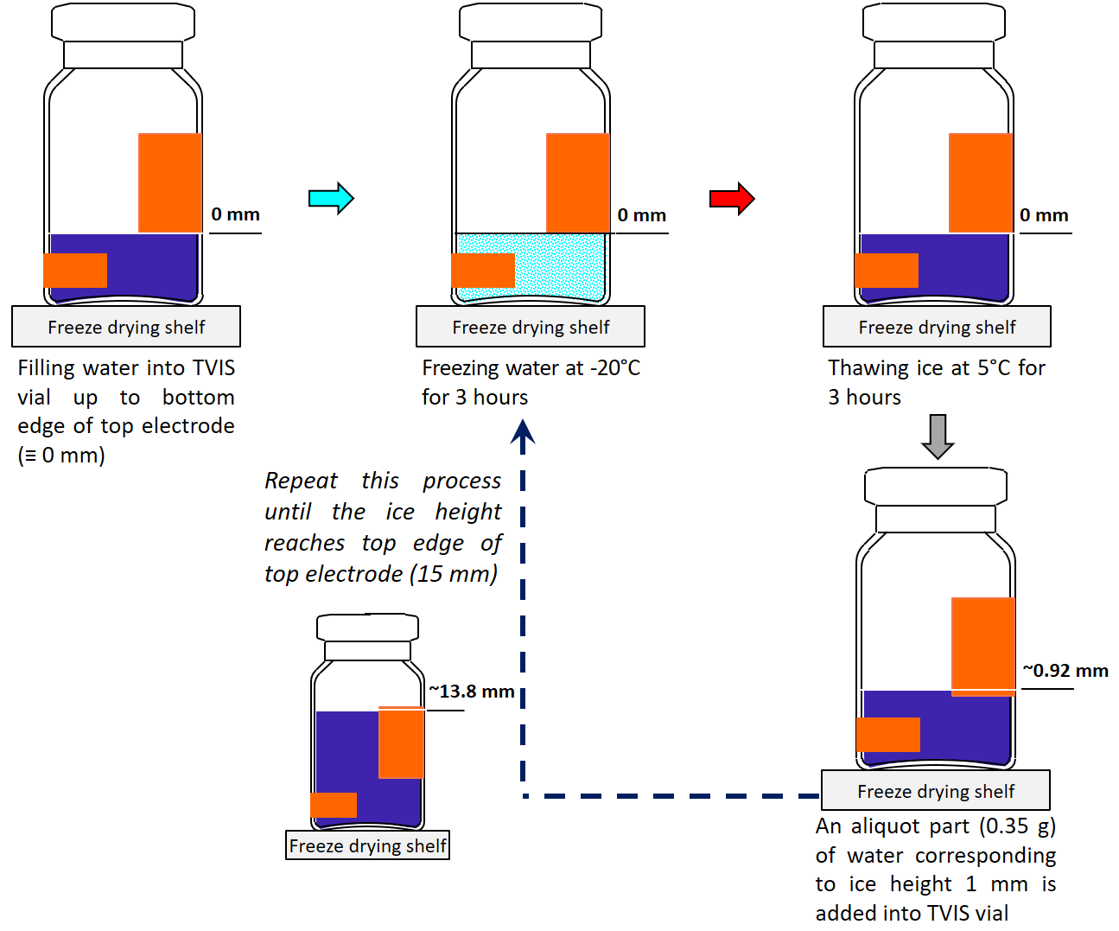

Slide 86
Objective
Prediction ice temperatures at (i) sublimation interface ($T_{i}$) and (ii) vial’s base ($T_{b}$) including qualification TVIS technique ($T_{i}=T_{\left(P_{i}=P_{c}\right)}$)
VII
At 2.4 h
$T_{\left(F_{PEAK}\right)BE}$ -30.6 ˚C
$$h=−5.93×T−176.79$$
$T_{\left(F_{PEAK}\right)TE}$ -32.3 ˚C
$T_{i}$ -33.1 ˚C
$T_{\left(F_{PEAK}\right)TE}$ -32.3 ˚C
19.46 mm
14.73 mm
9.46 mm
$T_{\left(F_{PEAK}\right)BE}$ -30.6 ˚C
3 mm
$T_{b}$ -29.8 ˚C
4.5 mm
5 mm
0 mm
2 mm
Freeze drying shelf
Ice height for${ T}_{\left(F_{PEAK}\right)TE}$ = $2+5+3+$($\frac{9.46}{2}$) = 14.73 mm
Ice height for $T_{\left(F_{PEAK}\right)BE}$ = $2+$($\frac{5}{2}$) = 4.50 mm
Ice height 19.46 mm at 2.4 h
$$h=−5.93×T−176.79$$
$$T=\frac{h+176.79}{−5.93}$$
Ice Temperature
At interface ($T_{i}$, 19.46 mm) = $\frac{h+176.79}{−5.93}=\frac{19.46+176.79}{−5.93}$ = -33.1 ˚C
At vial’s base ($T_{b}$, 0 mm) = $\frac{h+176.79}{−5.93}=\frac{0+176.79}{−5.93}$ = -29.8 ˚C

Slide 87
Objective
Prediction ice temperatures at (i) sublimation interface ($T_{i}$) and (ii) vial’s base ($T_{b}$) including qualification TVIS technique ($T_{i}=T_{\left(P_{i}=P_{c}\right)}$)
VII
$$T_{b}$$
At 2.4 h
$$h=−5.93×T−176.79$$
-30.6 ˚C
$$T_{\left(F_{PEAK}\right)BE}$$
$$T_{\left(F_{PEAK}\right)TE}$$
-32.3 ˚C
$T_{i}$ -33.1 ˚C
$T_{\left(F_{PEAK}\right)TE}$ -32.3 ˚C
$$T_{i}$$
19.46 mm
14.73 mm
9.46 mm
$T_{\left(F_{PEAK}\right)BE}$ -30.6 ˚C
3 mm
$T_{b}$ -29.8 ˚C
4.5 mm
5 mm
0 mm
2 mm
Freeze drying shelf
Ice height for${ T}_{\left(F_{PEAK}\right)TE}$ = $2+5+3+$($\frac{9.46}{2}$) = 14.73 mm
Ice height for $T_{\left(F_{PEAK}\right)BE}$ = $2+$($\frac{5}{2}$) = 4.50 mm
Ice height 19.46 mm at 2.4 h
$$h=−5.93×T−176.79$$
$$T=\frac{h+176.79}{−5.93}$$
Ice Temperature
At interface ($T_{i}$, 19.46 mm) = $\frac{h+176.79}{−5.93}=\frac{19.46+176.79}{−5.93}$ = -33.1 ˚C
At vial’s base ($T_{b}$, 0 mm) = $\frac{h+176.79}{−5.93}=\frac{0+176.79}{−5.93}$ = -29.8 ˚C

Slide 88
Ice Cylinder in Contact with the Inside of the Glass Wall
$$t_{1}$$
10.5 mm. from bottom edge of electrode ($∅=0.7)$
$$t_{1}$$
$$t_{2}$$
$$t_{2}$$
$$t_{3}$$
25% of ice has been removed ($∅=0.53)$
$$t_{3}$$
$$t_{4}$$
$$t_{4}$$
$$t_{5}$$
2 mm. from bottom edge of electrode ($∅=0.13)$
$$t_{5}$$
1
2
Notes:
Edge vial: Reduction in the drying rate is due to the reduction in the vertical surface area that received heat from radiation wall
Core vial: Any change in surface area might impact heat received from the radiation of top surface
Radiation is negligible

Slide 89
Ice Cylinder in Contact with the Inside of the Glass Wall
$$t_{1}$$
10.5 mm. from bottom edge of electrode ($∅=0.7)$
$$t_{1}$$
$$t_{2}$$
$$t_{2}$$
$$t_{3}$$
25% of ice has been removed ($∅=0.53)$
$$t_{3}$$
$$t_{4}$$
$$t_{4}$$
$$t_{5}$$
2 mm. from bottom edge of electrode ($∅=0.13)$
$$t_{5}$$
3
4
Notes:
Edge vial: Reduction in the drying rate is due to the reduction in the vertical surface area that received heat from radiation wall
Core vial: Any change in surface area might impact heat received from the radiation of top surface
Radiation is negligible

Slide 90
Ice Cylinder in Contact with the Inside of the Glass Wall
I
II
III
IV

Slide 91
Ice Cylinder in Contact with the Inside of the Glass Wall
A
B
I
II
$$t_{1}$$
$$t_{1}$$
$$t_{2}$$
$$t_{2}$$
$$t_{3}$$
$$t_{3}$$
$$t_{4}$$
$$t_{4}$$
$$t_{5}$$
$$t_{5}$$

Slide 92
Notes:
Edited in version 14

