Slide 1
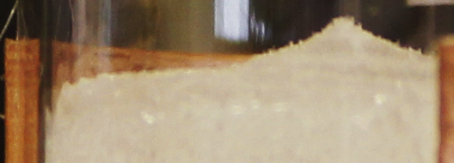
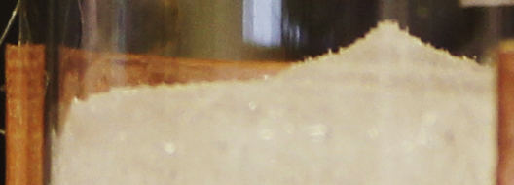
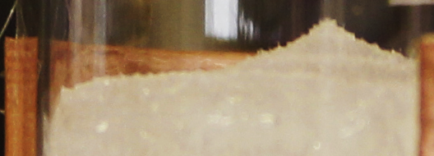
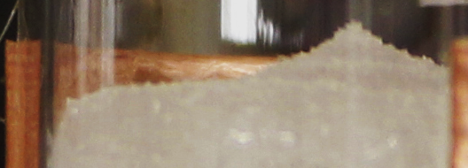
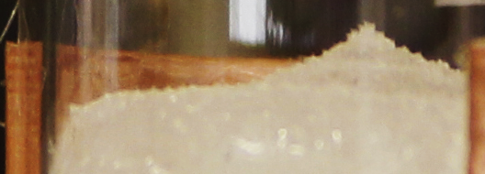
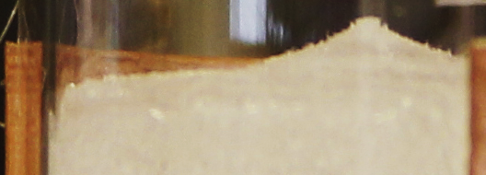
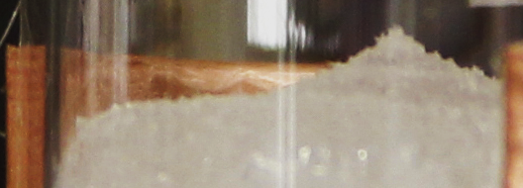
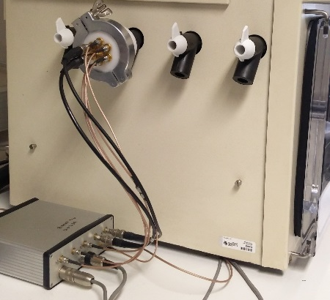
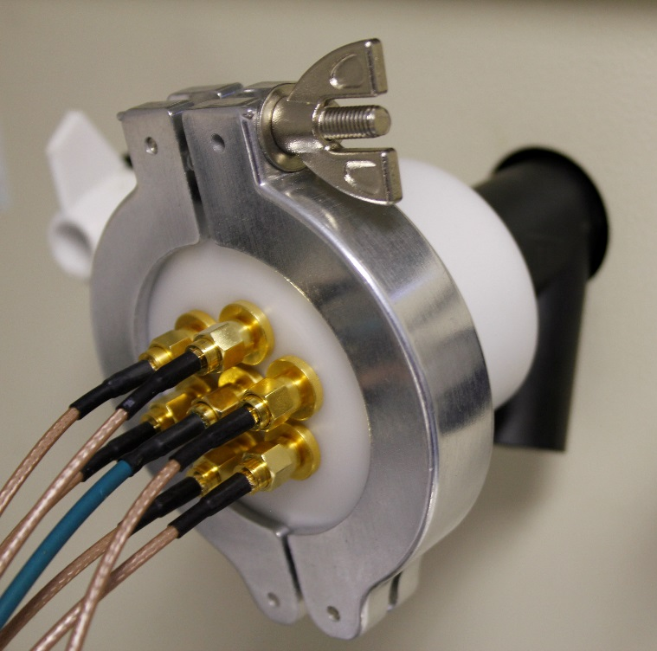
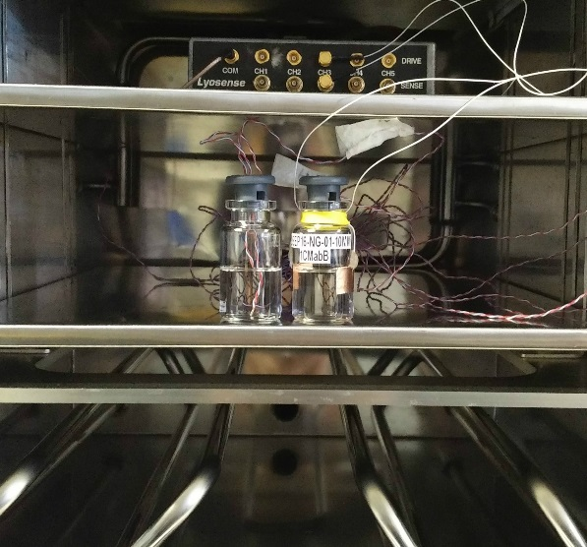
New Impedance Based Methodologies to Determine the Vial Heat Transfer Coefficient and the Endpoint of Primary Drying
Bhaskar Pandya, Geoff Smith*, Eugene Polygalov, Irina Ermolina
Leicester School of Pharmacy, De Montfort University, Leicester LE1 9BH, UK
*E-mail: gsmith02@dmu.ac.uk
APS 8th International PharmSci Conference, September 5-7, 2017; Hatfield, UK
ABSTRACT
Aims: To develop a new methodology to determine the vial heat transfer coefficient (K_{V}) and the endpoint of primary drying. Methods: During a freeze drying experiment, through vial impedance spectroscopy (TVIS) was be employed to measure the peak imaginary capacitance, C"_{PEAK}, from the imaginary spectra and the high frequency permittivity, C'(100 kHz), from the real spectra. C"_{PEAK} and C'(100 kHz) are considered to be highly sensitive to the amount of ice remaining in the vial. Results: Both the normalised time profiles of C"_{PEAK} and C'(100 kHz) followed the same trajectory within the first 15-20 % of ice sublimation and were therefore, used to estimate the sublimation rate and K_{V}. Whereas, the time profile of C'(100 kHz) alone was used to determine the endpoint of primary drying. A peak in the time profile of C'(100 kHz) towards the end of primary drying occurred around the same time as ice disappeared, as evidenced by time-lapse photography; Conclusions: K_{V} should be calculated only within the first 15-20% of primary drying and C'(100 kHz) can be followed to track the end point.
KEYWORDS: Freeze-drying, PAT, Drying Rate, Endpoint
INTRODUCTION
The freeze-drying cycle comprises (1) freezing to form ice and crystallise out any solutes, (2) primary drying to remove the ice phase by sublimation and (3) secondary drying to remove the remaining unfrozen water which is bound to the remaining matrix of crystalline and amorphous solids, Rey and May (2004). A better fundamental understanding of the coupled heat and mass transfer processes in primary drying requires the characterisation of the vial heat transfer coefficient (K_{V}). In industry, K_{V} is determined after the completion of ~30% of ice sublimation from the classic heat/mass balance equation,
K_{V} = dq/dt/ A.ΔT= (L.dm/dt)/ A.(T_{s}-T_{b})
where dq/dt is the rate of heat transfer from the shelf to the bottom of a given vial and is equal to the product of the latent heat of sublimation, L and the drying rate, dm/dt, divided by the product of the vial’s cross-sectional area, A and the difference between the product temperature, T_{b} and the shelf temperature, T_{s}, Pikal (1984). However, this calculation assumes that the ice layer has been drying in a horizontal plane from the beginning to the time corresponding to 30% of ice sublimation. The first objective of this work is to present a new methodology based on TVIS that was used to test whether the assumption is true.
Two parameters, C'(100 kHz) and C"_{PEAK}, of the real and the imaginary capacitance spectra of the TVIS vial, respectively, are considered to be proportional to the amount of ice remaining in the vial, Smith (2016). It is assumed that C"_{PEAK} is proportional to the height of the ice layer that is in contact with the glass wall (Figure 1) whereas C'(100 kHz) measures the bulk of the ice in the vial whether in contact with the vial wall or not. The surface area, A, is assumed to be constant and therefore, it is expected that C"_{PEAK} will decrease at the same rate as C'(100 kHz).
Frequently, the endpoint of primary drying is determined from product thermocouples among several other Process Analytical Technologies (PATs), none of which are free from limitations. The second objective of this work is to present a new methodology using TVIS to determine the endpoint of primary drying.
MATERIALS AND METHODS
Double distilled water from “all glass apparatus” was used in this study. The TVIS system comprises a bespoke multichannel high precision impedance analyser which was connected to a TVIS measurement vial, which is a standard 10 mL freeze drying vial (manufactured by Schott) that has been modified with copper electrodes (19 x 10 mm and 10 mm from the base of the vial) attached to the outside of the glass wall (Figure 2).
Two Type K thermocouples (TC) were submersed at a range of heights within ~6.6 g of distilled water contained in a clear vial so that the difference in temperature between the top and the bottom could be determined. A TVIS vial was also filled with ~6.6 g of distilled water. Both the vials were then freeze dried in a Virtis Advantage Plus benchtop freeze dryer (Figure 2), by freezing at a shelf temperature of −40 ºC at a ramp of ~36 °C h⁻¹, then temperature cycling to −10 ºC at a ramp of 30°C h⁻¹, (with a hold time of 1 h) and then subjected to primary drying at −15 ºC (40 Pa) until all of the ice disappeared. TVIS capacitance spectra and photographs of the ice sublimation process (using a Canon EOS 550D) were collected every two minutes throughout the freeze-drying process.
RESULTS AND DISCUSSION
The photographic evidence in Figure 3a shows that at the beginning of the primary drying (0 h) the solid ice block in the TVIS vial was made up of an ice cylinder (black dashed region) in intimate contact with the glass wall and an ice cone on top (dashed red lines).
The shape of the sublimation interface (the dashed top edge of the ice cylinder) does not change over the first 15-20% of sublimation (i.e. ~0.3-0.5 h). Over this period, C"_{PEAK} was found to be proportional to C'(100 kHz) on the normalised scale (equivalent to 15-18% of ice sublimation) (Figure 3b). During this brief period, the gradient (i.e. drying rate: 2.02 g/h) was determined from the assumption C"_{PEAK} and C'(100 kHz) are both proportional to the amount of ice remaining in the vial.
Figure 3b shows a divergence of C"_{PEAK} and C'(100 kHz) at 0.5 h owing to the fact that the surface area of the sublimation interface increased from 0.5 h onwards, as confirmed by the photographs.
The temperature difference between TC_{top} and TC_{base} was ~2ºC over the first 0.2 h of primary drying (Figure 3c) after which TC-top started to increase owing to the fact that the TC-top was no longer in contact with the ice layer (photograph not shown)
The K_{V} (~261.3 W m⁻² K⁻¹) value was determined over the first 0.5 h from the heat/mass balance equation, where L = 2844 Jg⁻¹ and dq/dt = 5745 Jh⁻¹, ice temperature was 244.5 K (recorded from TC_{base}), shelf temperature was 258 K and A = 0.00045 m⁻². As expected, K_{V} was 8-10 times higher than the range of values found in the literature (15-25 W m⁻² K⁻¹ at 40 Pa), Brülls (2002) as a consequence of the fact that the current study was undertaken on an isolated vial whereby the radiant heat from the side walls would contribute significantly to the heat transfer co-efficient.
The second objective of this work was to present a new methodology for determining the endpoint of primary drying based on the TVIS parameter C'(100 kHz), which ends in a plateau towards the end of primary drying (Figure 4a). An enlarged version of the plot (Figure 4b) shows a point at which C'(100 kHz) reaches a peak (before decreasing) which corresponds to the point at which the ice disappears as evidenced by time-lapse photography.
CONCLUSIONS
Two conclusions may be made from this work (i) In the case of an isolated vial, K_{V} should be determined within the first 15-20% of primary drying before the ice interface starts to deviate from a planar drying that would otherwise result in uncertainties in the estimation of the surface area of the ice interface, (ii) The time profile of C'(100 kHz) may be used to detect the endpoint of primary drying.
ACKNOWLEDGEMENTS
A GEA Pharma Systems and Astra Zeneca collaboration and co-funded by Innovate UK.
REFERENCES
Brülls, M., Ramusson, A., 2002. Heat Transfer in Lyophilization. Int J Pharm, 246 (1-2), 1-16.
Pikal, M.J., Roy, M.L., Shah, S., 1984. Mass and Heat Transfer in Vial Freeze-Drying of Pharmaceuticals: Role of the Vial. J Pharm Sci, 73 (9), 1224-1237.
Rey and May (2004) Informa Healthcare. Freeze Drying-Lyophilization of Pharmaceutical and Biological Products (3rd Edt)
Smith G. Through vial impedance spectroscopy. Podium presentation at: SMi Lyophilisation Europe; 2016 Jul 4-5; London, UK.
Planar
Sublimation Front
Non planar sublimation front
0 h
0.6 h
Drying Rate
2.02 g/h
Non Linear
0.1 h
0.7 h
Divergence of C"PEAK and C'(100kHz) at 0.5 h
0.2 h
0.8 h
0.0
0.3
0.6
1.0
1.3
1.6
2.0
0.3 h
0.9 h
T_{shelf} −15 ºC
(b)
0.4 h
1 h
TC_{top}
TC_{base (up to 30 min)} = ~-28.5 ºC
0.5 h
1.1 h
ΔT_{0.2 h} = ~2.5 ºC
PRIMARY DRYING
(a)
0.0
0.3
0.6
1.0
1.3
1.6
2.0
C"_{PEAK}
(c)
C"_{PEAK} reduces
during
Primary
Drying
Figure 3: (a) Photographs of the sublimation interface showing a sublimation interface with a constant surface area over the first 0.5 h of of primary drying; (b) Convergence of C"_{PEAK} and C'(100 kHz) parameters over the first 15-20% of sublimation; (c) Difference between the thermocouple temperature close to the top of the ice layer (TC_{top}) and at the base of the vial (TC_{base})
F_{PEAK}
Ice Height assumed to be proportional to C"_{PEAK}
Figure 1: Relationship between C"_{PEAK} and the height of the ice layer
TVIS endpoint ~24h
C'(100kHz)/pF
(a)
(b)
TVIS junction box
Figure 4: (a) Time profile of C'(100 KHz); (b) and (c) TVIS endpoint agreed with the visual endpoint
Current to Voltage Converter
TC(top)
Electrodes
10mm
Pass Through
Freeze Dryer Chamber
TC(bottom)
10mm
Distilled water ~6.6 g
Figure 2: Experimental Set Up

