Slide 1
Novel electrical impedance methods in formulation and process development
Prof. Geoff Smith
School of Pharmacy, De Montfort University, Leicester LE1 9BH

Slide 2
Overview – Vienna
Introduction to electrical impedance and dielectric relaxation spectroscopy
Micro-scale measurements in a freeze-drying microscope; applications for formulation screening
In-vial measurements in a freeze-dryer: applications for process development

Slide 3
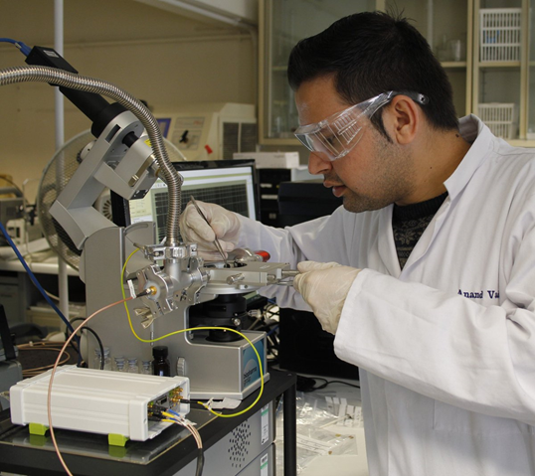
Acknowledgements
for Funding for Z-FDM development (FastLyo Project 133425)
In collaboration with ….
Anand Vadesa (PhD 2018)
Funded by UKRI – EPSRC

Slide 4
Dielectric loss or dielectric permittivity analysis?
Electrical Impedance Spectroscopy and Dielectric Relaxation Spectroscopy Techniques

Slide 5
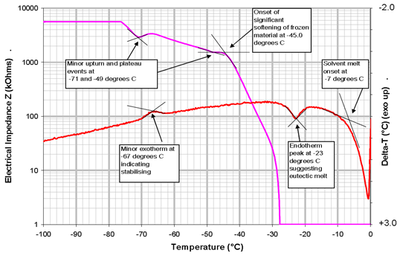
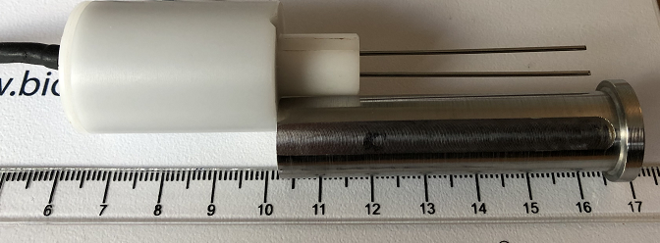
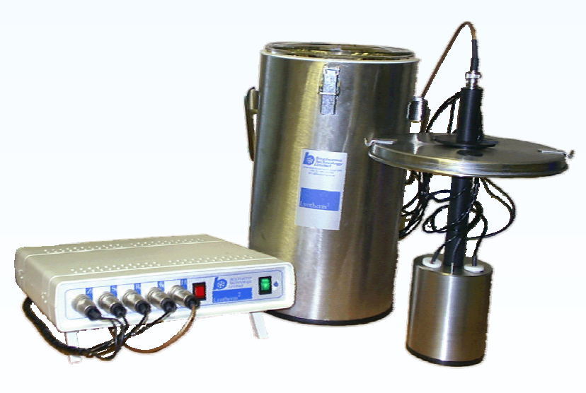
Single frequency (1 kHz) Electrical Impedance Analysis
Lyotherm – Integrated impedance analysis (Zsinφ) and DTA
designed to measure glass transition (Tg’), eutectic (Teu) and melting (Tm) temperatures relevant to freeze-dried formulations
Pin electrode (pair)
Integrated within cryostat
Ward & Matejtschuk , 2010 in Freeze Drying/ Lyophilization of Pharmaceutical & Biological Products 3rd ed. Rey,L & May JC eds, Informa Press, New York

Slide 6
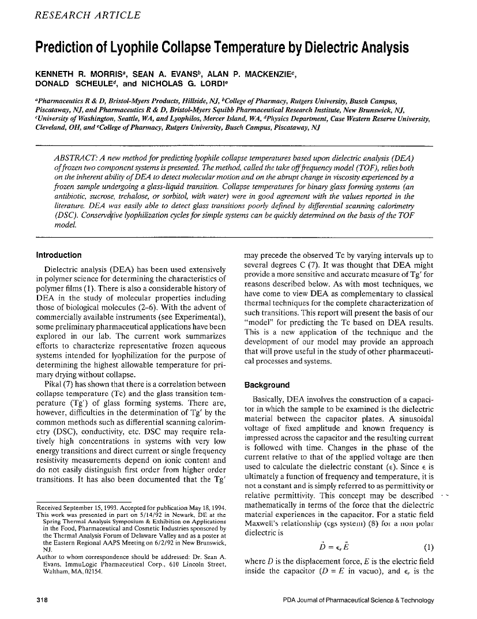
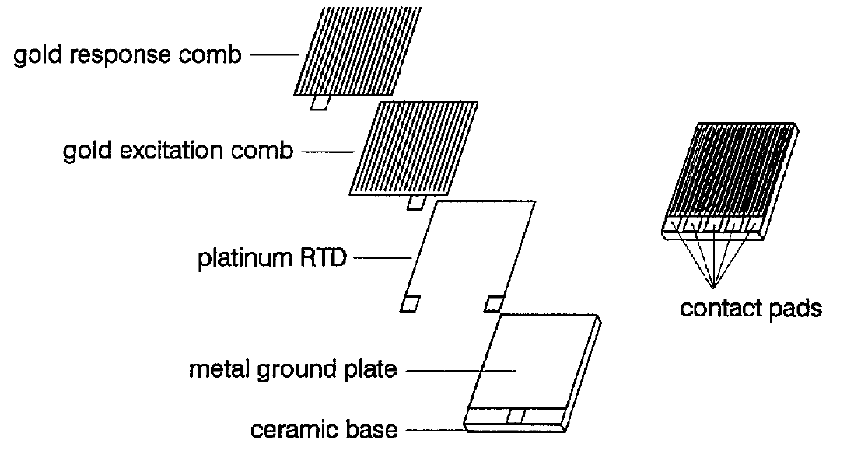
Interdigitated electrodes
Interdigitated electrodes have been used in past for the prediction of lyophile collapse temperature
A
B
A: Showing individual components of a single surface, co-planer, interdigitated-comb sensor and B: the complete sensor
Mackenzie, A. P., Evans, S. A. and Morris,. Prediction of Lyophile Collapse Temperature by Dielectric Analysis Prediction of Lyophile Collapse Temperature by Dielectric Analysis, PDA J Pharm Sci and Tech 1994, 48 318-329.
Notes:
MORRIS, K.R. et al. Prediction of Lyophile Collapse Temperature by Dielectric Analysis Prediction of Lyophile Collapse Temperature by Dielectric Analysis, PDA J Pharm Sci and Tech 1994, 48 318-329.
Evans, S.A. et al. Dielectric Characterization of Thermodynamic First Order Events in Model Frozen Systems Intended for Lyophilization Dielectric Characterization of Thermodynamic First Order Events in Mode ! Frozen Systems Intended for Lyophiiization, PDA J Pharm Sci and Tech 1995, 49 2-8

Slide 7
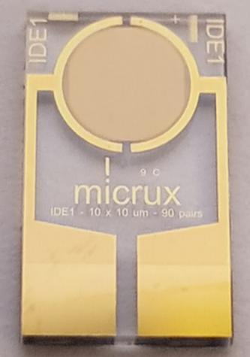
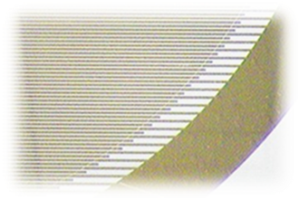
Example interdigitated electrode (gold on glass)
Width of the electrode 3.5 mm Ø
Light aperture 1.3mm diameter
10 μm
10 μm
Electrode gap
Electrode width
Commercial IDE – MicruxTM
Notes:
http://www.linkam.co.uk/fdcs196-specifications
https://static1.squarespace.com/static/556d800ae4b0e8f91507450c/t/56cf3686f8baf3fe56cc48e2/1456420522066/FDCS196_T95_manual.pdf

Slide 8
Design of IDE holder
Top view
Theoretical sample height
6 mm
16mm
6 mm
10mm
10 mm
*
0.85 mm*
*IDE height 0.75 mm
* different height of IDE adaptors used for initial assessment:
0.85 mm
0.90 mm
0.95 mm
1.00 mm
IDE is lower than the adapter and sample height derived between difference between then IDE adaptor size
IDE dimensions:
10 x 6 x 0.75 mm
Notes:
https://static1.squarespace.com/static/556d800ae4b0e8f91507450c/t/56cf3686f8baf3fe56cc48e2/1456420522066/FDCS196_T95_manual.pdf

Slide 9
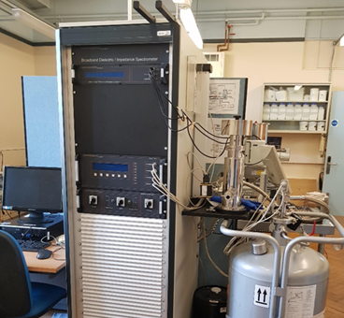
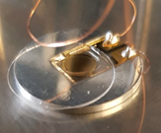
Spectroscopy Systems : BDS (sub Hz to 10 MHz)
Inter-digitated electrode
Integrated within the BDS cryostat
Novocontrol BDS system
Commercial state of the art broad-band dielectric spectrometer (BDS) from Novocontrol GmbH (mHz to 10 MHz)
Adapter & spacer
Cover
slip

Slide 10
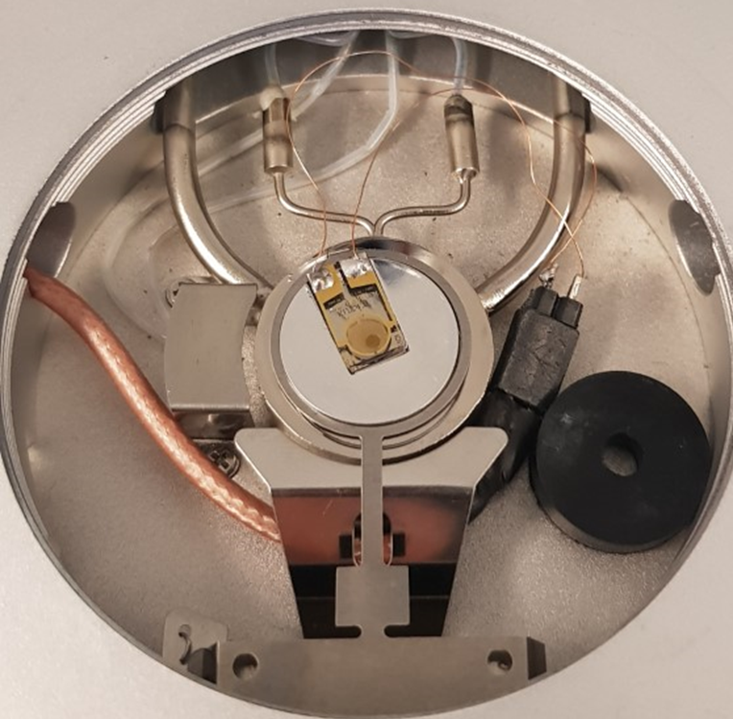
Spectroscopy Systems : Z-FDM
Inter-digitated electrode
Integrated within the FDM stage
Developed in partnership with Biopharma Process Systems
on Innovate UK funded FAstLyo project ref. 133425 (2018-19)

Slide 11
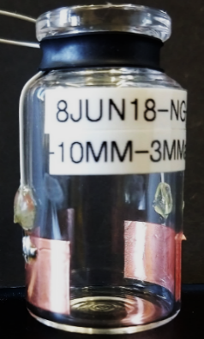
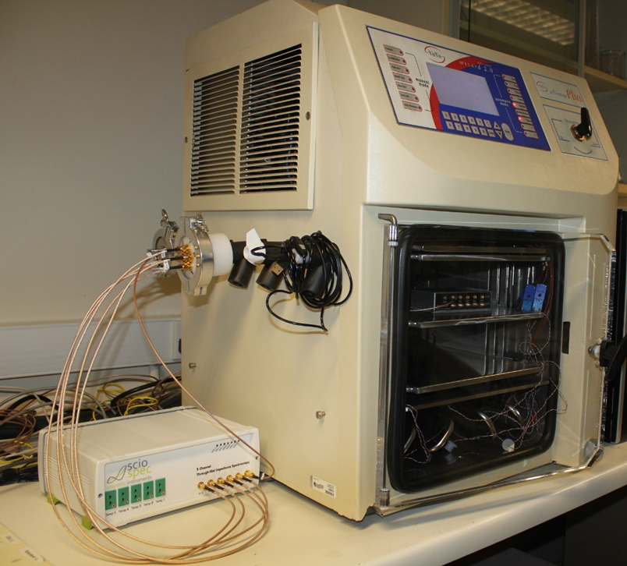
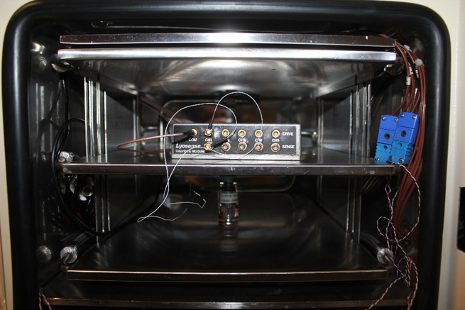
Spectroscopy Systems : TVIS
Modified glass vial
Integrated within the dryer
TVIS (Through-Vial Impedance Spectroscopy) was developed in partnership with GEA Pharma Systems on Innovate UK funded LyoDEA project (2010-13)
Pass through
Junction box
vial

Slide 12
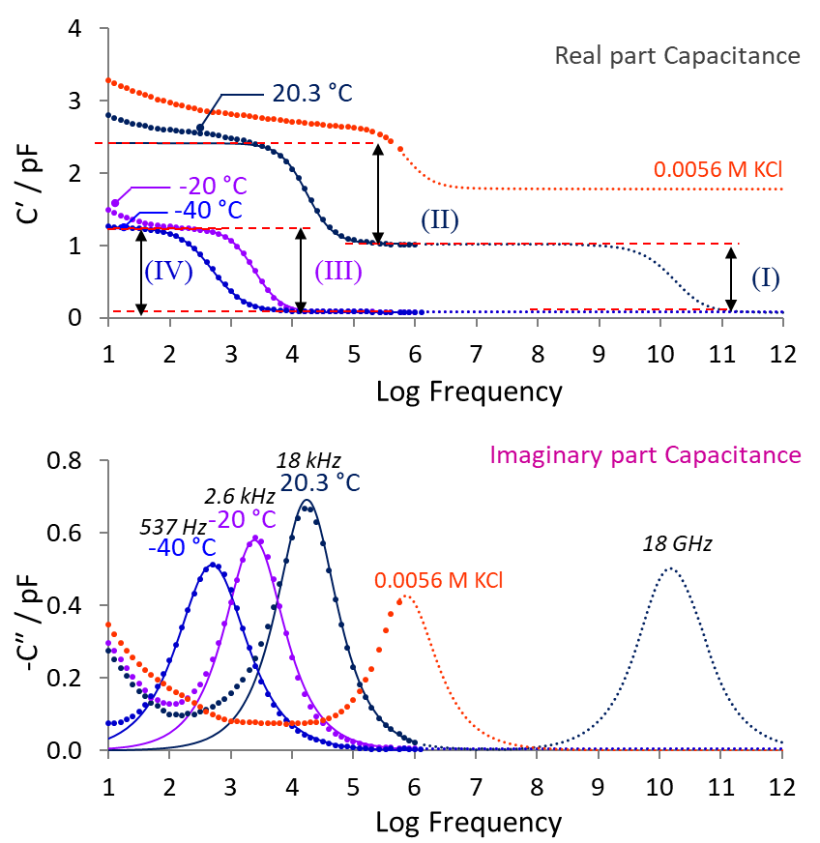
Dielectric Loss Mechanisms
1 kHz Lyotherm measurement frequency
The polarization of the water dipole in liquid water at 20 ˚C, with a dielectric loss peak frequency of ~ 18 GHz
Maxwell-Wagner (MW) polarization of the glass wall of the TVIS vial at +20 ˚C, with a dielectric loss peak frequency of 17.8 kHz
The dielectric polarization of ice at −20 ˚C, with a dielectric loss peak frequencies of 2.57 kHz
The dielectric polarization of ice at −40 ˚C with a dielectric loss peak frequencies of 537 Hz.
Note: Process II only seen in TVIS vial; in Z-FDM process II is replaced by electrode polarization impedance)
Notes:
D:\PhD\Assignment\Conference ppt\Plot used in smi 2019 Conference_v1

Slide 13
Further Reading
Introduction to TVIS theory
Description of the measurement principles
Dielectric loss and relaxations mechanisms (liquid and frozen states)

Slide 14
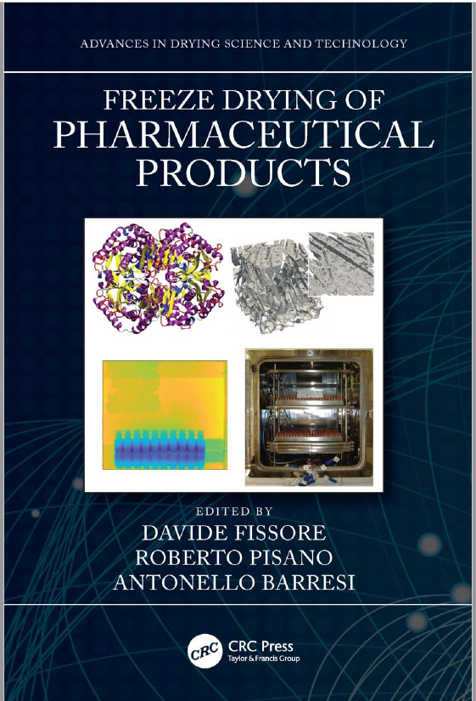
Further Reading
Chapter 5 Through Vial Impedance Spectroscopy (TVIS) A New Method for Determining the Ice Nucleation Temperature and the Solidification End point
Notes:
Baook cover

Slide 15
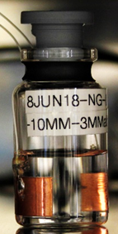
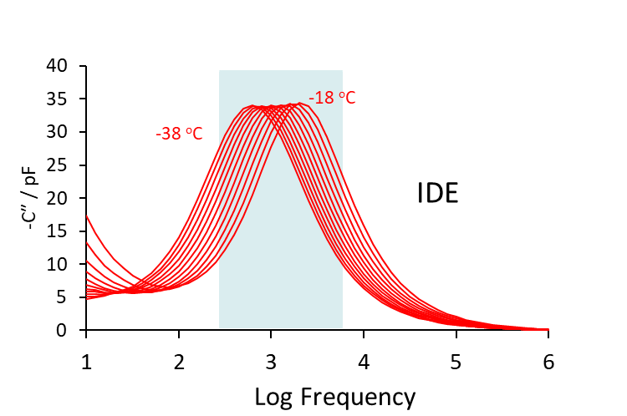
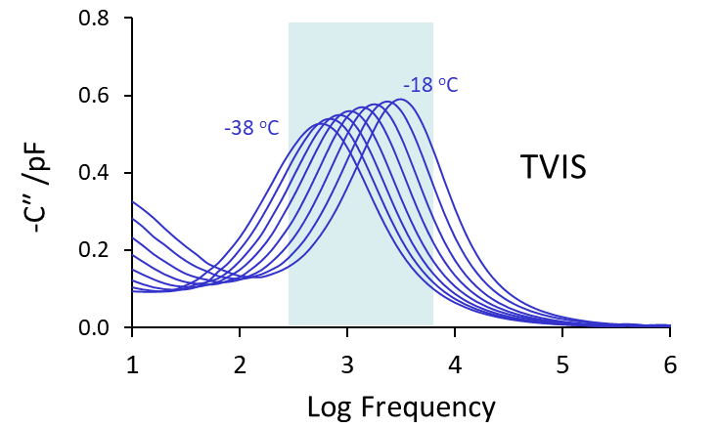
Dielectric relaxation of ice
5 mL water in
10 mL glass TVIS vial
(1 pair of 10/19 mm height/width electrodes)
10/10 μm electrode width/spacing
2 µL water over IDE
(90 pairs of gold interdigitated electrodes)
1.6 kHz temperature sensitive

Slide 16
Dielectric loss or dielectric permittivity analysis?
Micro-scale measurements in a freeze-drying microscope; applications for formulation screening
Z-FDM : A description of the new measurement system

Slide 17
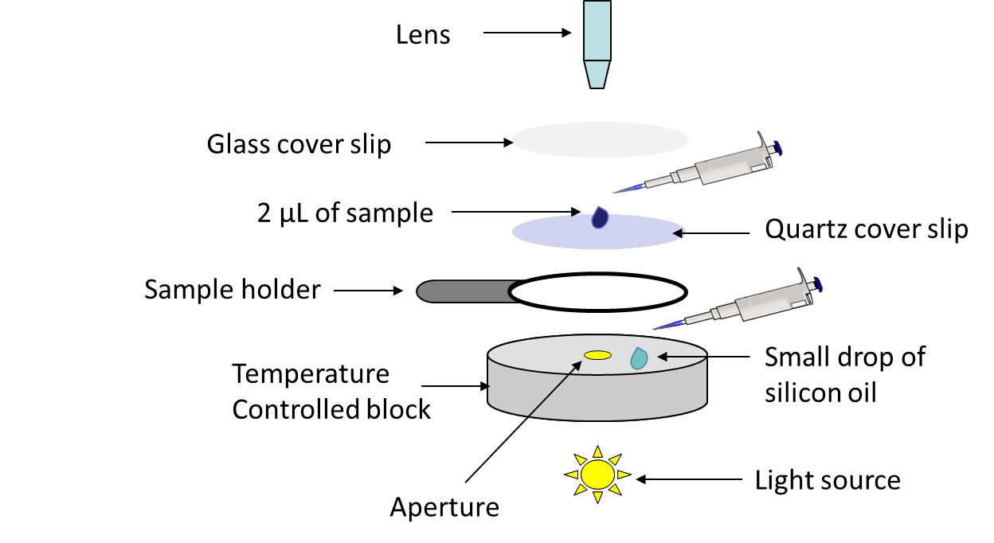
Freeze drying microscopy
Real-time observation of the behavior of formulations during freeze drying and typically used for study Critical Temperatures of a formulation
In amorphous products this is the collapse temperature (T_{c})
In crystalline solutions this is the eutectic point (T_{eu})
Biopharma Lyostat5 FDM
Notes:
FDM primarily set up to study collapse

Slide 18
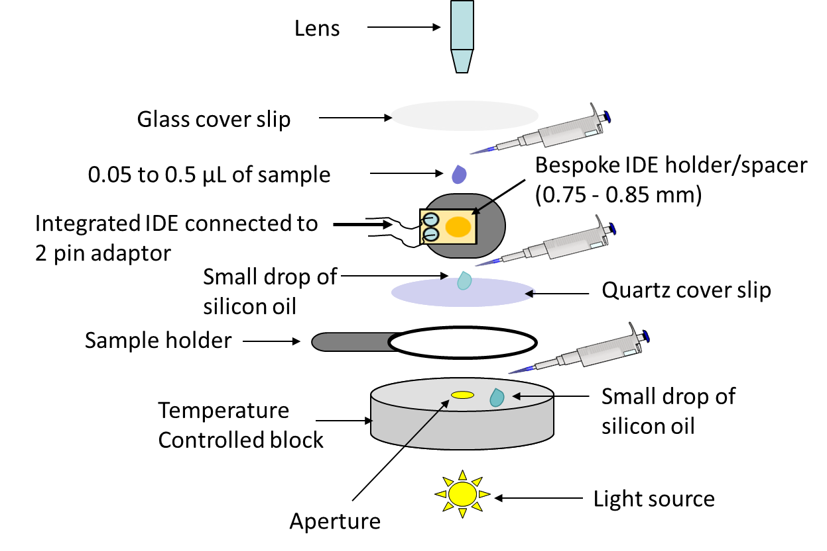
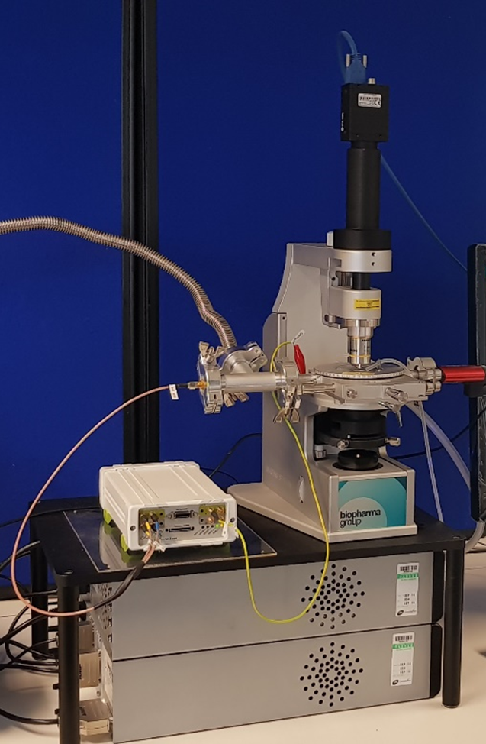
Impedance enabled Freeze drying microscopy
Impedance analyzer connected to the FDM with bespoke adapters
FDM stage remains intact, and IDE sit above the quartz cell
Gold IDE does not affect the optical application of the FDM
Z-FDM
Notes:
FDM primarily set up to study collapse

Slide 19
Z-FDM with TASC and Image Analysis
Combined approaches provides comprehensive analysis of critical parameters
TBC : To be confirmed in this presentation.
*Vadesa A, Smith G, Horley N, Ward K, Dalby P. Application of a novel impedance-based freeze drying microscopy for formulation development. Podium & Poster presentation at ISL-FD 9th International Conference 2-6th September, 2019, Ghent, Belgium. February 2020. doi:10.21253/DMU.9767048
**Requires all of the sample to be within view of the camera
Event | Visual assessment | TASC/pixel analysis | Impedance
Collapse | Yes (Subjective) | Yes | Yes*
Eutectic melt | Yes (Subjective) | Yes | ??
Glass transition (T_{g}’) | No | ?? | TBC
Ice nucleation | Yes | Yes** | Yes*
Solidification end | Yes | Yes** | Yes*
Annealing | No | ?? | TBC
Drying rate | No | Yes | TBC

Slide 20
Publications suggestive of Z-FDM application
Smith, G., Jeeraruangrattana, Y., Ermolina, I. (2018). The application of dual-electrode through vial impedance spectroscopy for the determination of ice interface temperatures, primary drying rate and vial heat transfer coefficient in lyophilization process development. European Journal of Pharmaceutics and Biopharmaceutics
Smith, G., Arshad, M.S., Polygalov, E., Ermolina, I., McCoy, T.R., Matejtschuk, P. (2017). Process Understanding in Freeze-Drying Cycle Development: Applications for Through-Vial Impedance Spectroscopy (TVIS) in Mini-pilot Studies. Journal of Pharmaceutical Innovation, 12 (1), pp. 26-40 Key observation was the potential to measure temperature non-invasively
Arshad, M.S., Smith, G., Polygalov, E., Ermolina, I. (2014). Through-vial impedance spectroscopy of critical events during the freezing stage of the lyophilization cycle: The example of the impact of sucrose on the crystallization of mannitol. European Journal of Pharmaceutics and Biopharmaceutics, 87 (3), pp. 598-605
Smith, G., Arshad, M.S., Polygalov, E., Ermolina, I. (2014). Through-Vial Impedance Spectroscopy of the Mechanisms of Annealing in the Freeze-Drying of Maltodextrin: The Impact of Annealing Hold Time and Temperature on the Primary Drying Rate. Journal of Pharmaceutical Sciences, 103 (6), pp. 1799-1810
Smith, G., Arshad, M.S., Nazari, K., Polygalov, E., Ermolina, I. ; Taylor, J., Page, T. (2014) Through-Vial Impedance Spectroscopy: A New In-Line Process Analytical Technology for Freeze Drying. Pharmaceutical Technology, 38 (4), pp. 38-46
Smith, G., Arshad, M.S., Polygalov, E., Irina Ermolina, I. (2014) Factors Affecting the Use of Impedance Spectroscopy in the Characterisation of the Freezing Stage of the Lyophilisation Process: the Impact of Liquid Fill Height in Relation to Electrode Geometry. AAPS PharmSciTech, 15 (2), pp 261–269
Smith, G., Arshad, M.S., Polygalov, E. and Ermolina, I. (2013) An application for impedance spectroscopy in the characterisation of the glass transition during the lyophilization cycle: The example of a 10% w/v maltodextrin solution. European Journal of Pharmaceutics and Biopharmaceutics, 86 (3 Part B), pp. 1130-1140.
Smith, G., Polygalov, E., Arshad, M.S., Page, T., Taylor, J., Ermolina, I. (2013) An impedance-based process analytical technology for monitoring the lyophilisation process. International Journal of Pharmaceutics, 449 (1-2), pp. 72-83

Slide 21
Applications in freezing (nucleation temperature, ice growth rates, solidification end point)
Observations on Sample Size
Case study of 5% w/v Sucrose Solution

Slide 22
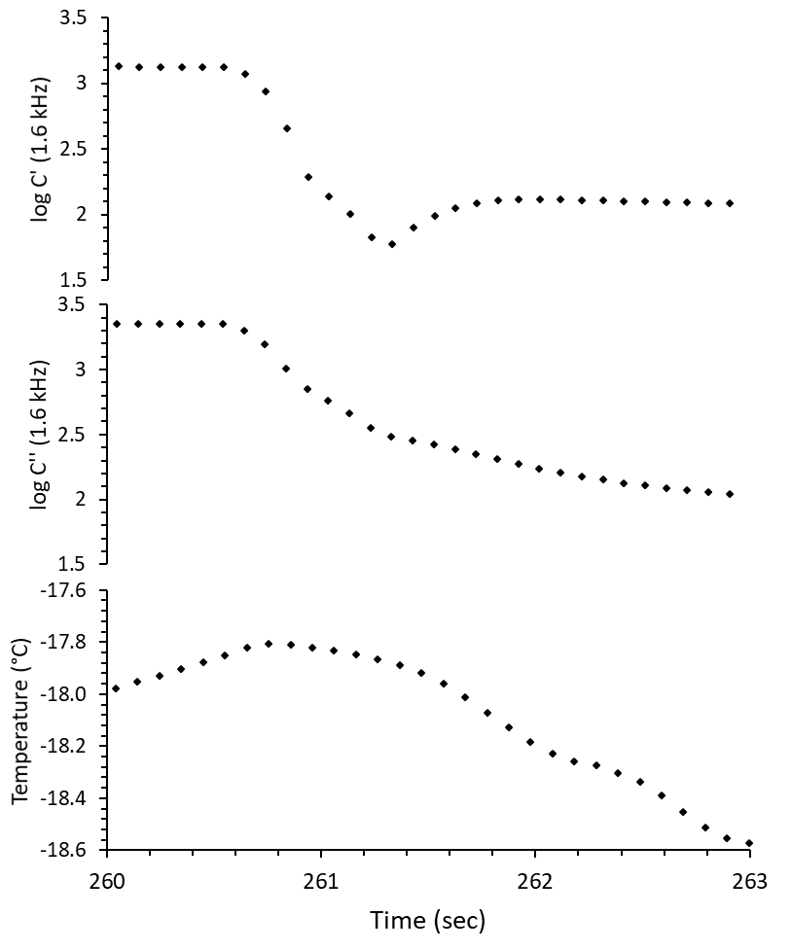
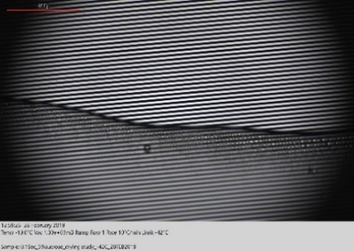
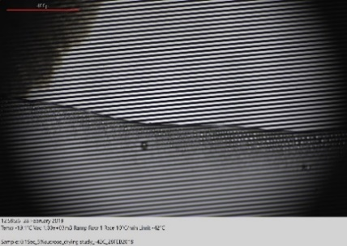
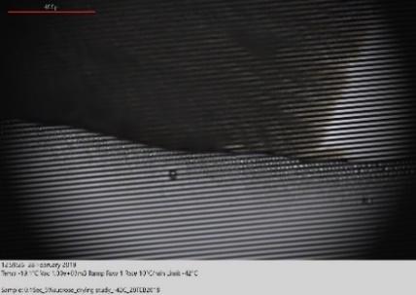
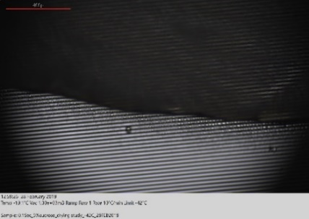
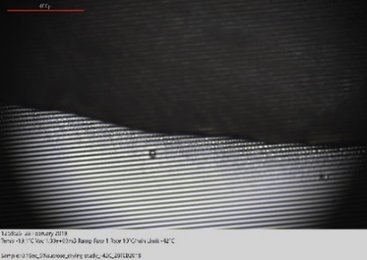
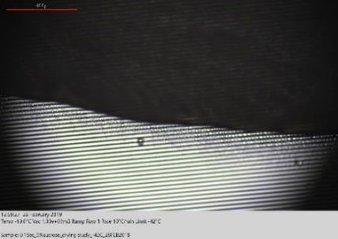
Nucleation of 0.5µL of 5% Sucrose
1
3
5
1
2
2
6
4
B. Ice solidification
end point time/temp
Time difference between time points A and B is the ice solidification time and hence provides an opportunity to measure ice growth rates at the mean ice growth temperature (C)
3
4
A. Nucleation
Temperature/time
C. Mean ice growth
Temperature – 17.9
5
6
Ice solidification
time = 1.2 s

Slide 23
Ice growth rates
1 mL of 5% w/w sucrose has 0.95 g water
Assumption: unfrozen fraction comprises 80:20 ratio of sucrose to water
It follows that 0.0125 g (0.05 x 20/80) is bound and produces 0.9375 g ice
Estimated from:
Larger sample : 0.5 µL of 5% sucrose (produces 4.688E-04 g ice)
Ice formation time = 1.2 s (12 data points – more accurate)
Ice growth rate: 4.688E-04 / 1.2 = 0.39 mg/s
Relevance : ice crystal size?

Slide 24
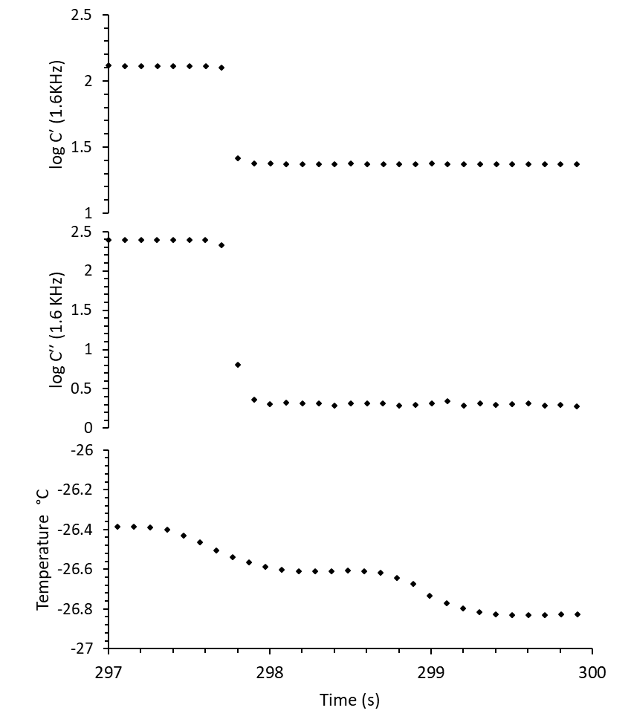
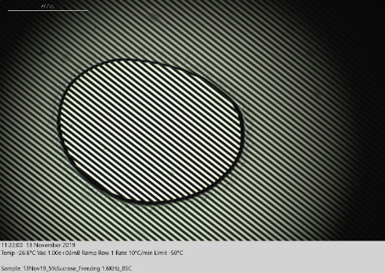
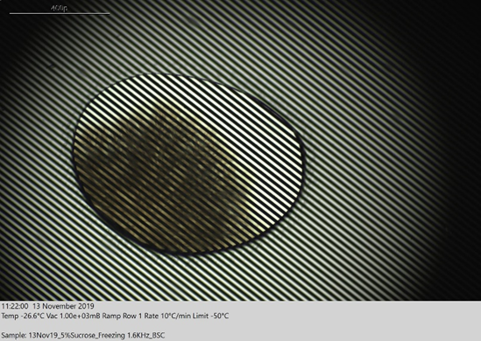
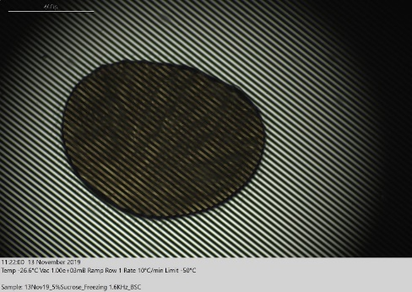
Nucleation of 0.05 µL of 5% Sucrose
2
1
4
3
1
2
Ice solidification
time
3
4
Notes:
Z-FDM records the change in liquid, i.e. onset and end point of freezing when these two processes are outside the view of the microscope.

Slide 25
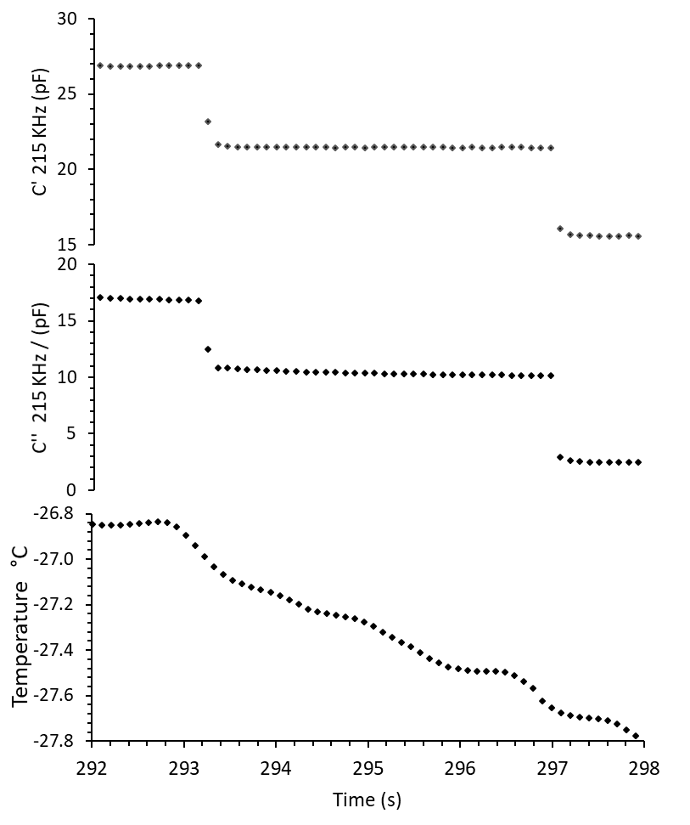
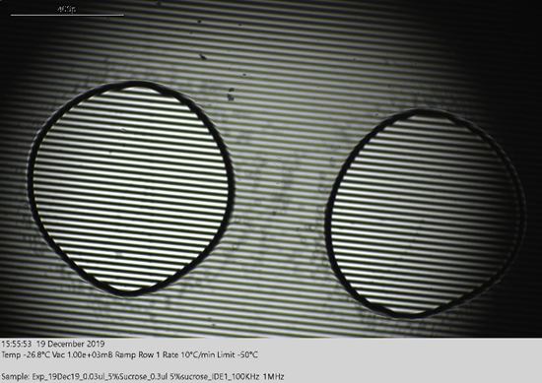
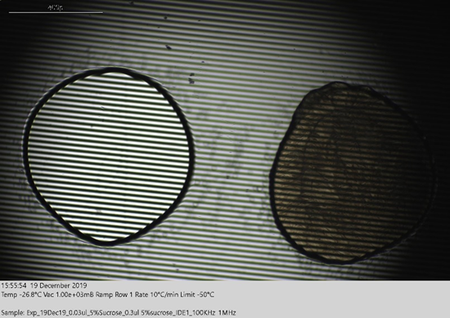
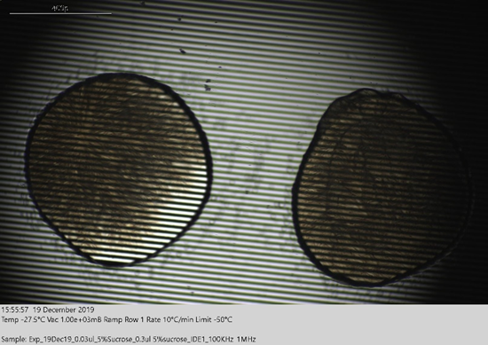
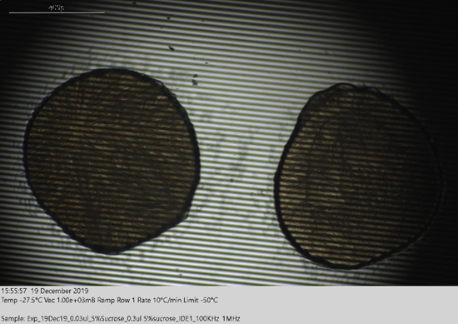
Nucleation of 2 x 0.03 µL of 5% sucrose
2
3
1
4
Ice solidification
time
1
2
Ice solidification time
3
4

Slide 26
Dielectric loss or dielectric permittivity analysis?
Applications in primary drying (drying rate, product collapse)
Freeze drying of 5% sucrose (0.05μL)
Studied by Image analysis

Slide 27
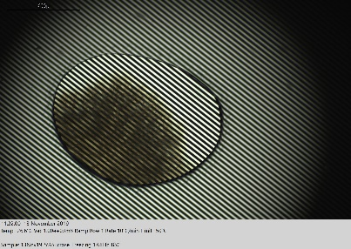
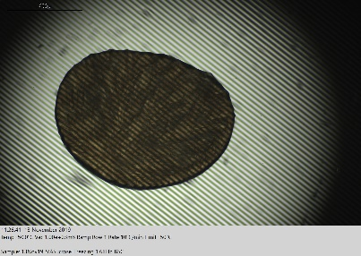
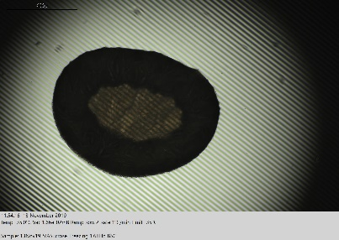
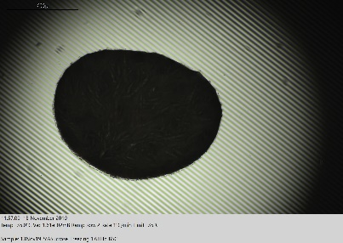
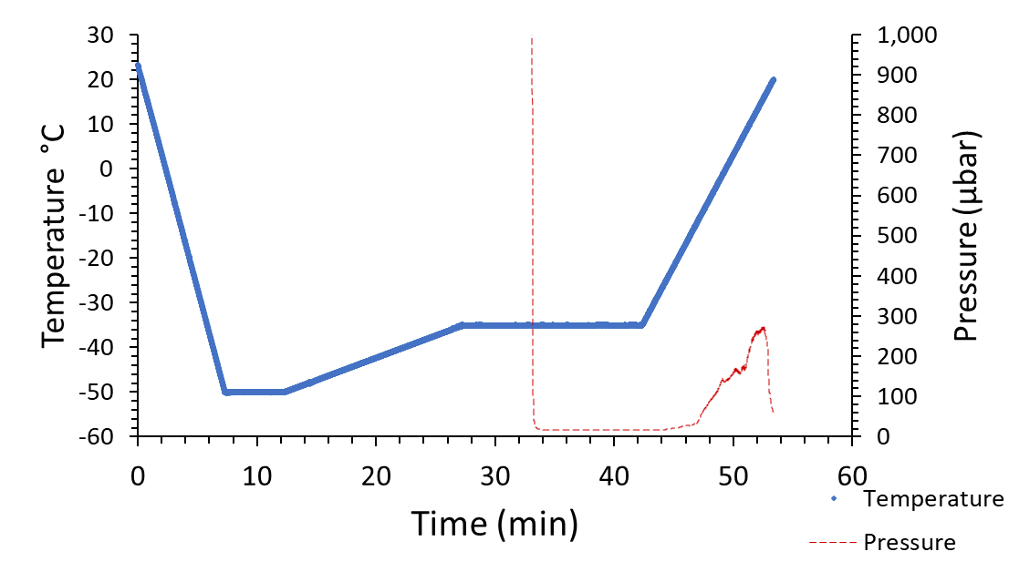
FDM protocol
Liquid state
ice growth
ice solidification
sublimation
end of primary drying
FDM freeze-drying of 5% sucrose solution (0.05 μL)
Time period for image analysis by TRAC and Matlab
NB: Temperature and pressure measured on FDM every 100 ms
Notes:
Its animation
V4 has all raw data linked

Slide 28
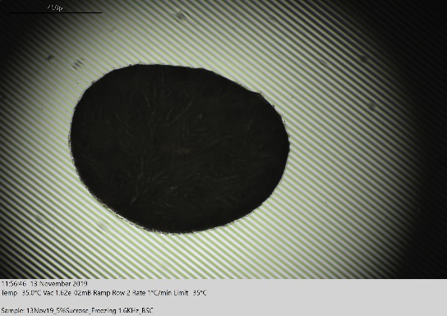
MATLAB® Image analysis (pixel counting)
FDM primary-drying of 5% sucrose soln (0.05 μL) at -35˚C
Global templet generation – dried product image
Threshold test image – frozen image or drying stage image
MATLAB®
Global pixel : 527515
Dried product image
MATLAB®
Pixel for central area: 86317
Product during drying

Slide 29
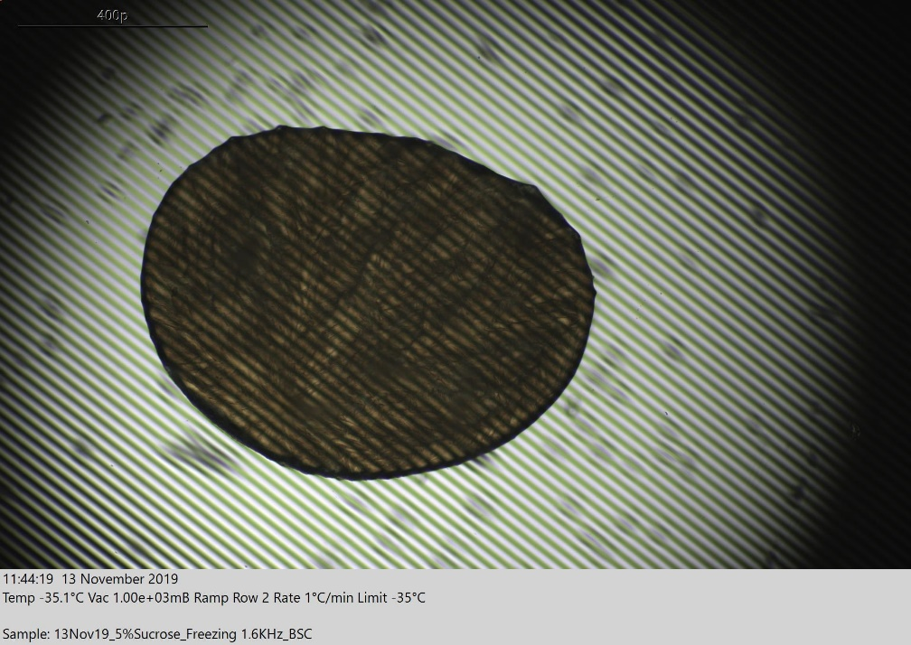
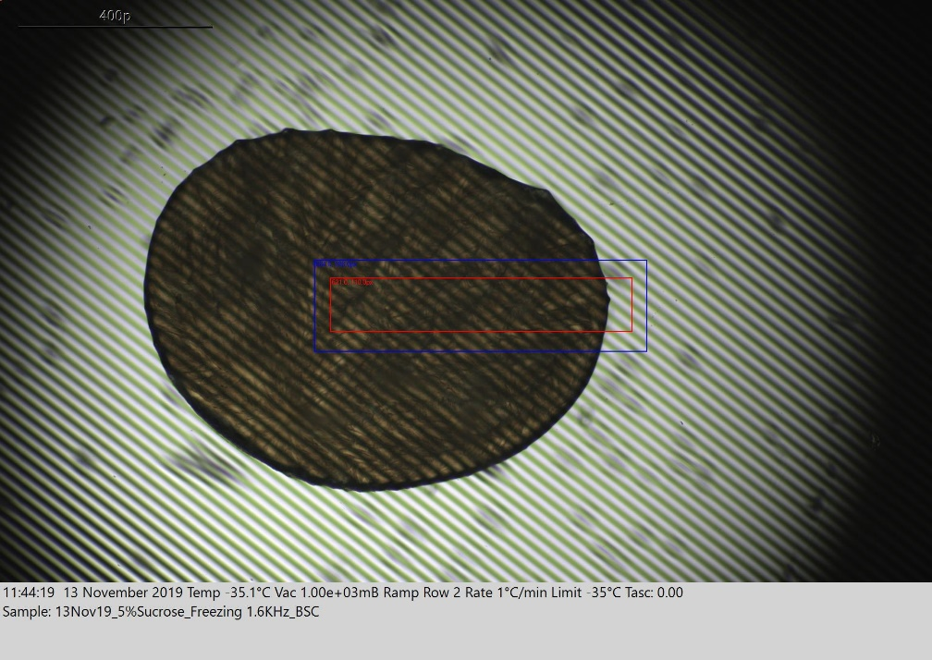
TASC - description
Thermal Analysis by Surface Characterisation (TASC) works by analyzing a sequence of images and tracking the changes from one to another
First, select the range of analytical run (e.g. drying period)
Select a ‘region of interest’ that need needs to be tracked (red box)
Then select a ‘region to be scanned’ (blue box)
0.00
Notes:
Its animation
Thermal Analysis by Surface Characterisation (TASC) is a software addition to the Lyostat that is used to analyse data files generated by the LINK software post-analysis

Slide 30
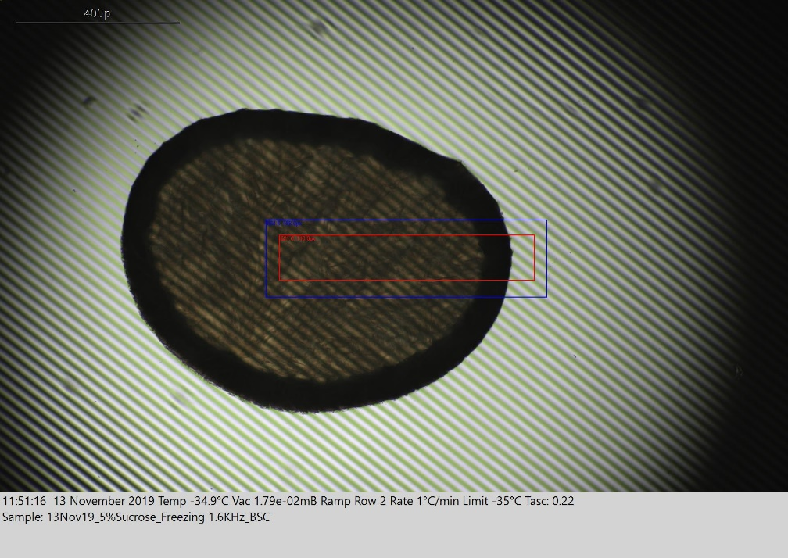
TASC - description
Thermal Analysis by Surface Characterisation (TASC) works by analyzing a sequence of images and tracking the changes from one to another
First, select the range of analytical run (e.g. drying period)
Select a ‘region of interest’ that need needs to be tracked (red box)
Then select a ‘region to be scanned’ (blue box)
0.22
Notes:
Its animation
Thermal Analysis by Surface Characterisation (TASC) is a software addition to the Lyostat that is used to analyse data files generated by the LINK software post-analysis

Slide 31
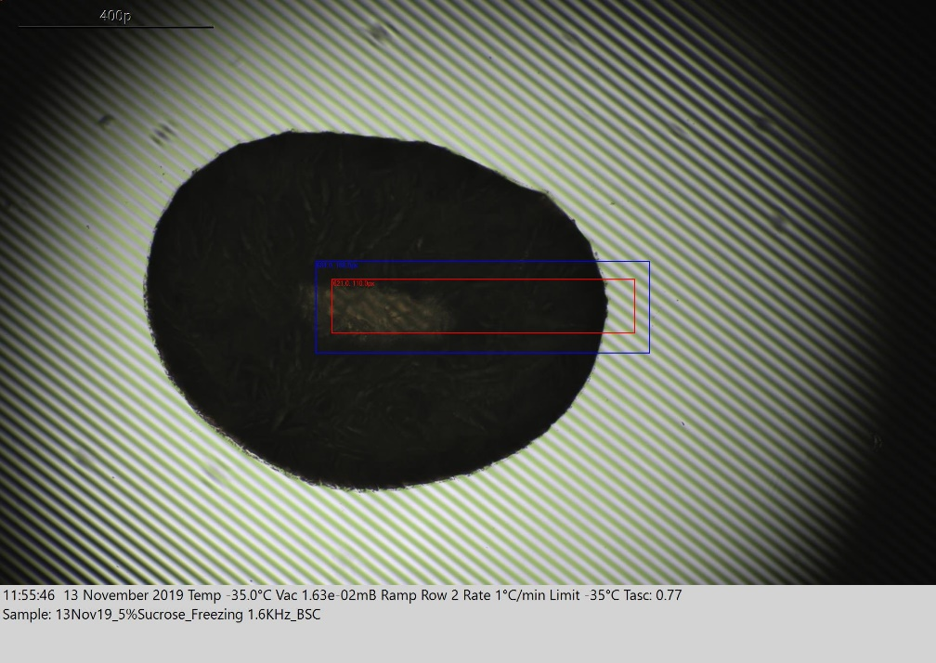
TASC - description
Thermal Analysis by Surface Characterisation (TASC) works by analyzing a sequence of images and tracking the changes from one to another
First, select the range of analytical run (e.g. drying period)
Select a ‘region of interest’ that need needs to be tracked (red box)
Then select a ‘region to be scanned’ (blue box)
0.77
Notes:
Its animation
Thermal Analysis by Surface Characterisation (TASC) is a software addition to the Lyostat that is used to analyse data files generated by the LINK software post-analysis

Slide 32
TASC - description
Thermal Analysis by Surface Characterisation (TASC) works by analyzing a sequence of images and tracking the changes from one to another
First, select the range of analytical run (e.g. drying period)
Select a ‘region of interest’ that need needs to be tracked (red box)
Then select a ‘region to be scanned’ (blue box)
0.87
Notes:
Its animation
Thermal Analysis by Surface Characterisation (TASC) is a software addition to the Lyostat that is used to analyse data files generated by the LINK software post-analysis

Slide 33
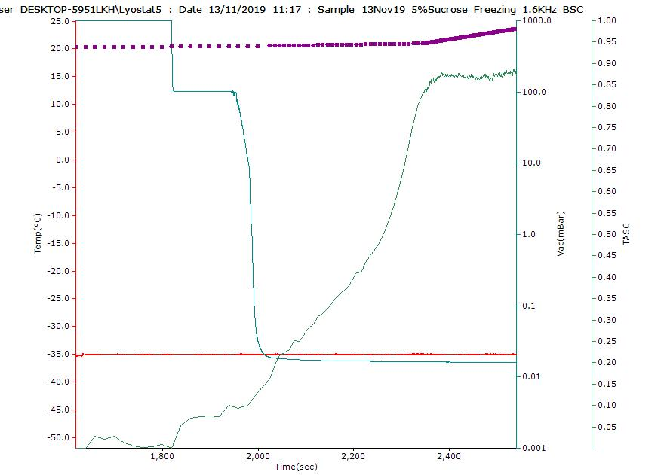
TASC - description
Thermal Analysis by Surface Characterisation (TASC) works by analyzing a sequence of images and tracking the changes from one to another
First, select the range of analytical run (e.g. drying period)
Select a ‘region of interest’ that need needs to be tracked (red box)
Then select a ‘region to be scanned’ (blue box)
Notes:
Its animation
Thermal Analysis by Surface Characterisation (TASC) is a software addition to the Lyostat that is used to analyse data files generated by the LINK software post-analysis

Slide 34
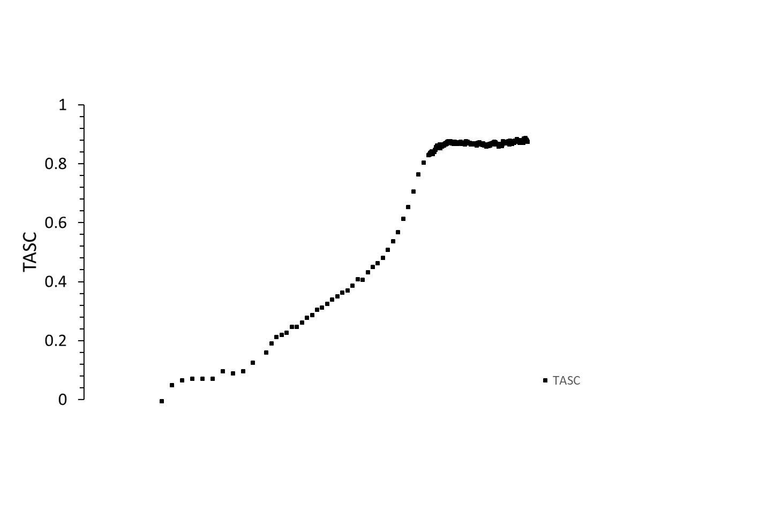
Comparison of TASC and Pixel analysis
A
TASC has similar profile
A: Application of vacuum
NB: Temperature and pressure measured every 100 ms
Notes:
Its animation

Slide 35
Drying rate determination
0.8 mm
76µm
Weight fraction of sucrose | 0.05 | (5% Sucrose)
Weight fraction of water | 0.95 | i.e. 95 % water
Weight fraction of bound water (1) | 0.0125
Weight fraction of freezable water | 0.9375
Sample volume | 0.05 | µL
Freezable water | 0.0469 | µL
Freezable water in mg | 0.0469 | mg of ice
Total pix before drying starts | 466873
1 pixel (a) | 1.004E-07 | mg of ice
Gradient of linear part (b) | 132110 | pixel per min (yellow line)
Drying rate (a x b) | 0.0133 | mg min⁻¹
Drying rate (B) | 0.00080 | g h⁻¹
Area of perimeter of sample (A) | 0.00342 | cm²
Specific drying rate (B/A) | 0.233 | g h⁻¹ cm⁻²
Area of perimeter
0.00342 cm²
0.62 mm
(1) based on 80:20 ratio of sugar to water in freeze-concentrated solution
NB: Sample thickness assumed from the Lactose sample analysed in the same setup.
Example drying rate from a 10 mL glass tubing vial is 0.25 g h⁻¹
Vial diameter : 22 mm Internal area : 3.8 cm⁻¹
Specific drying rate : 0.065 g h⁻¹ cm⁻²
Difference due to differences in heat transfer etc.

Slide 36
Drying rate at different gradient
Application of vacuum
A
B
B
B
C
C
B
Drying Rates
At A Initial – 0.00080g h⁻¹
At B: Middle – 0.00050 g h⁻¹
At C: Middle – 0.00041 g h⁻¹
NB: Temperature and pressure measured every 100 ms
Notes:
0.000549217

Slide 37
Dielectric loss or dielectric permittivity analysis?
Freeze drying of 5% sucrose (0.05μL)
Studied by Z-FDM

Slide 38
Drying: Image analysis vs Capacitance during drying of 0.05 µL 5%sucrose
I
II
III
IV
Linear relationship between real part capacitance C’ and pixel count (ice content) confirms the opportunity to use Z-FDM for drying rate estimation
A
I: Application of vacuum. Primary drying starts
II: Both gradients of imaginary and real part capacitance change towards the end of drying
II : end of primary drying
IV: Ramped to RT and capacitance remains unchanged with temperature
B

Slide 39
Dielectric loss or dielectric permittivity analysis?
Annealing of 5% sucrose (0.05μL)
Studied by Z-FDM

Slide 40
Full process
0.05 µL 5%sucrose
A
Annealing stages
B
C
D
E
Capacitance data measured at 1.6KHz

Slide 41
Annealing (1.6KHz)
0.05 µL 5%sucrose
Structural changes on re-heating
decrease with each annealing
Excursions in temperature just above the glass transition

Slide 42
Applications in primary drying : product collapse
Collapse of 5% sucrose (0.5 µL)
Studied by Z-FDM

Slide 43
TASC – image analysis of sucrose solution
Reduces operator error in the analysis of the the collapse temperature and can use for drying rate.
A
B
A
B
Collapsed layer
T_{c} −32.1°C
T_{c}(onset) −33.3˚C
Adapted from: Ward, K. and Matejtschuk, P., 2019. Chapter 1 Characterization of Formulations for Freeze-Drying In: K. R. WARD and P. MATEJTSCHUK, eds, Lyophilization of Pharmaceuticals and Biologicals: New Technologies and Approaches. 1 edn. New York: Humana Press, pp. 1-33.
Images coinciding with TASC features
onset of collapse at −33.3°C, and
full collapse occurring at −32.1°C
Notes:
Image analysis is less subjective and can be used for drying rate

Slide 44
Collapse Observation at 1 kHz
Vacuum applied
II
I
I
III
II
III
NB: 0.5 μl of 5% Sucrose soluiton

Slide 45
Take home messages (from measurements at 1.6 KHz)
Real and imaginary part capacitances can be used for the determination of ice nucleation and ice growth rates
Pixel analysis works for drying rate determination (TASC can also be used)
Real capacitance has a linear relationship with pixel count, and hence ice mass, so can be used for drying rate determination
Imaginary part capacitance can be used to study the annealing process but requires further work in order to be able to determine the glass transition temperature.
Selection of a higher measurement frequency is likely to provide the answer to the glass transition temperature assessment
Step changes in drying rate (observed from real part capacitance) can be used to determine the collapse temperature (in a similar way to TASC)
Relevance of the results is questionable because of differences in sample size, heat transfer etc. to product container

Slide 46
Acknowledgements, Recent Projects & Collaborators
De Montfort University, School of Pharmacy
Anand Vadesa. PhD student
Neill Horley. Senior Lecturer
Glen McCann: Lecturer
University College London
Prof. Paul Dalby
Biopharma Process Systems
Kevin Ward
Berlin
@LyoGroupDMU
Our data
Our Twitter Page
Our WebPage
LyoDEA
Lyophilization process analytics
By dielectric analysis
Government Support for industry
Biopharmaceutical Stability at
Room Temperature
Analytical Technologies for the
Stabilization of Biopharmaceuticals
Notes:
Biopharma Process Systems
Dr Kevin Ward
University College London
Professor Paul Dalby

