Slide 1
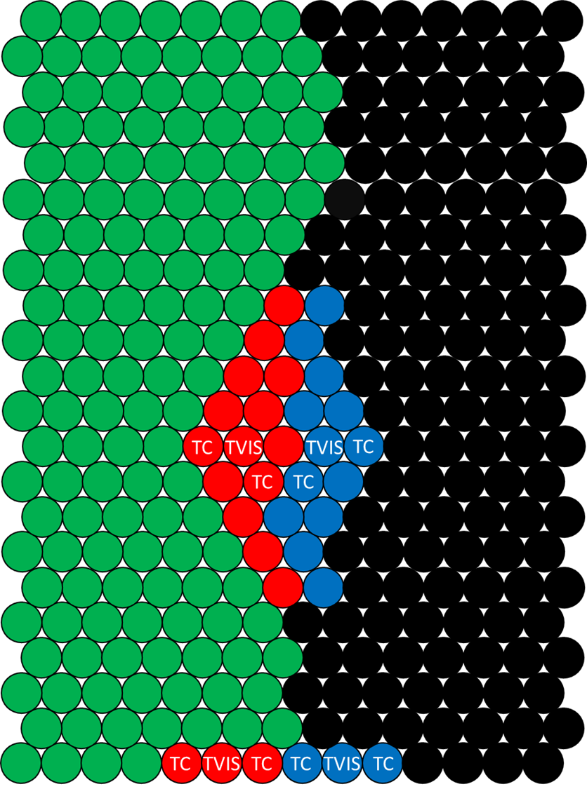
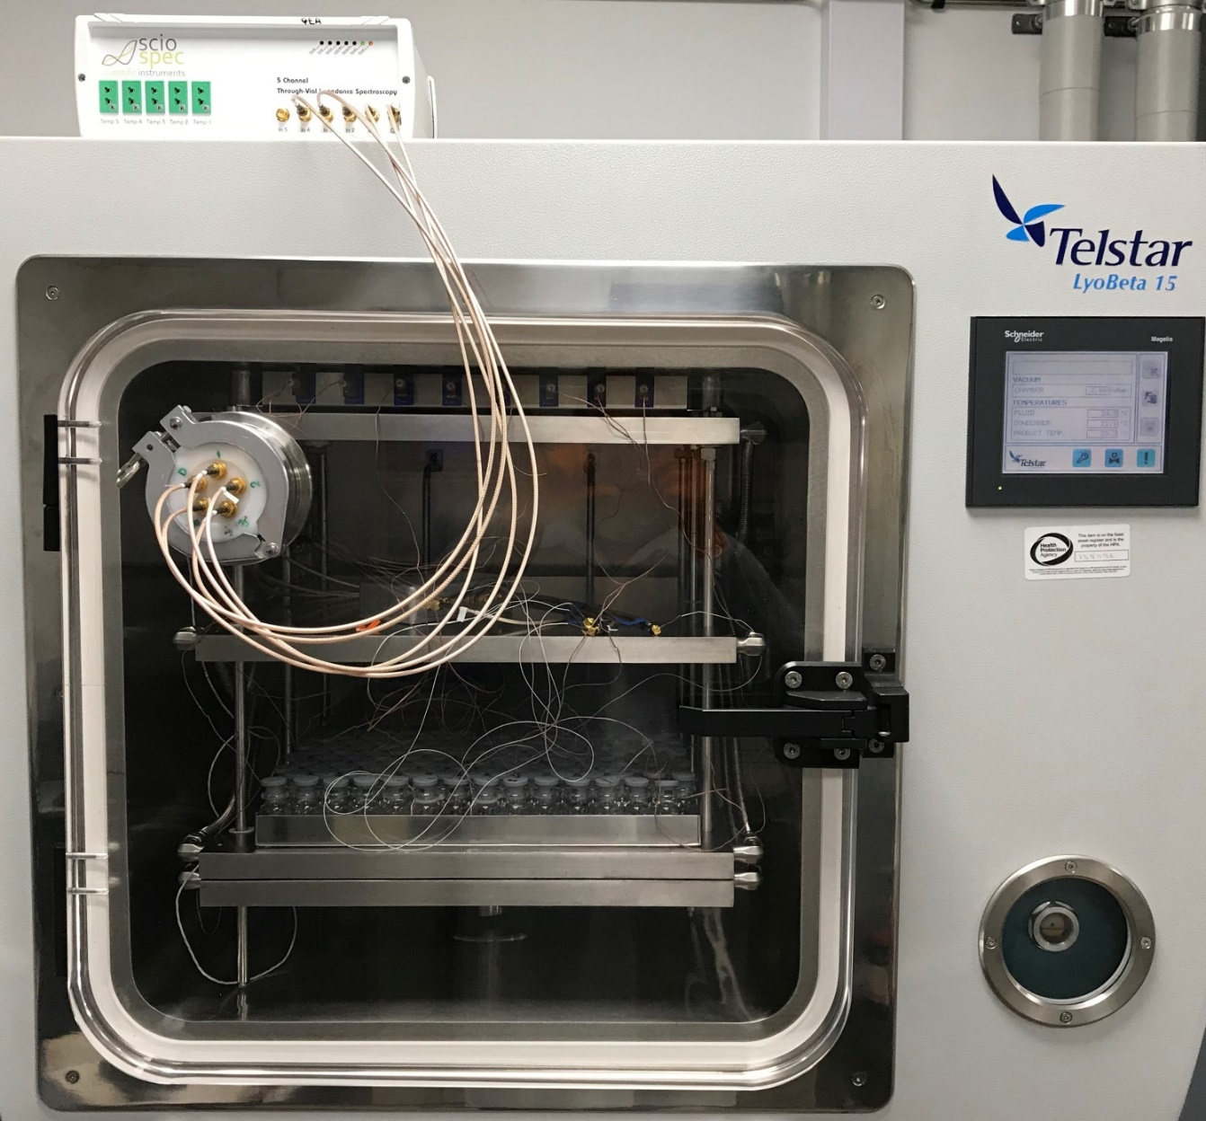
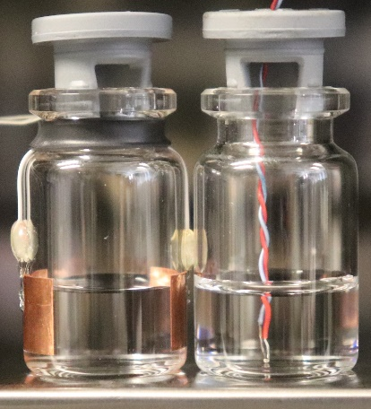
Multiplexing Through Vial Impedance Spectroscopy (TVIS)
with Comparative Pressure Measurement
for the Determination of the Primary Drying Endpoint of Immunoglobulin (IgG)
ISL-FD’s 9th International Symposium on Lyophilization of Pharmaceuticals, September 2-6, 2019, Ghent, Belgium
Bhaskar Pandyaª, Paul Matejtschuk^{b}, Yowwares Jeeraruangrattanaª, Geoff Smithª, Irina Ermolinaª
ªLeicester School of Pharmacy, De Montfort University, Leicester, United Kingdom
^{b}National Institute of Biological Standards and Control (NIBSC), Potters Bar, United Kingdom
Introduction
Attaining a long-term stability by freeze-drying can be attractive as it can eliminate the need for cold chain storage of biopharmaceutical products (e.g. proteins).
A precise determination of the point of complete ice removal during primary drying has been one of the strategies for avoiding product collapse or eutectic melt [1].
Common batch techniques include the comparative pressure measurement: the Pirani gauge (more sensitive to the water vapour) with a capacitance manometer (CM) (controls the absolute pressure of the chamber). The point at which the Pirani pressure approaches that of CM is taken as the endpoint for the whole batch [2].
Single vial techniques (e.g. thermocouples, resistance temperature detectors, etc) involve inserting an invasive probe into the product to measure the product temperature, which when equals the shelf temperature, is generally taken as the endpoint for the batch; but it is known that probe containing vials dry faster than the vials without the invasive probes and front row edge vials receive an additional heat contribution via heat radiation from the Plexiglass door [3].
Through Vial Impedance Spectroscopy (TVIS) senses the amount of ice in the vial in real time by measuring the dielectric properties of the frozen solid by employing a pair of copper electrodes attached externally to a single vial (i.e. non-product invasive) [4].
Previously, the time-line of the imaginary part capacitance at 1 kHz, C"(1kHz), has been used to determine the primary drying endpoint for a simple sucrose solution [4].
Aim and Objectives
The aim of this study is to develop an impedance-based methodology to determine the primary drying endpoint with the following objectives:
to use the time-line of the C'(100kHz) parameter for determining the primary drying endpoint of ice in a complex protein formulation located at the edge and the core
to compare the endpoint from TVIS with the endpoint given by the comparative pressure measurement
Materials and Methods
5% Sucrose placebo
4:1 Mannitol:Sucrose placebo
Impedance analyser
Freezing: 20 ºC to -50 ºC
at 0.2 ºC/min,
Semi-permeable membrane
IgG
Pore
TVIS vial
TC vial
Passthrough
2 annealing steps
(to -15 ºC and -28 ºC)
Electrodes
4% IgG
(Width 19mm)
4% IgG
10 mm
Primary drying step at T(shelf) -25 ºC for 73 h
4:1
Mannitol: Sucrose
5 % Sucrose
3 mm
Core TVIS Vials
(1) 10 x 2 mL IgG Ampoules at
2-8ºC
(3) Solutions prepared with 20 mM Histidine Buffer and 0.01% Tween 20 pH 6.5
4 TVIS vials: 1 of each IgG formulation in edge and core
8 TC vials: 2 TC vials per TVIS vial (Type T thermocouples)
Edge TVIS Vials
Secondary drying step at T(shelf) of 30 ºC
(2) Dialysis
(4) 3 g dispensed in each of
the 308 x 5 mL vials (Adelphi VC-005-20C)
(5) Set up- Telstar Lyobeta 15 Dryer
with Sciospec 5-channel TVIS System
(6) Freeze Drying for ~113 h
Results and Discussion
4% IgG- 5% Sucrose Core TVIS Vial
The dielectric relaxation of ice was characterized by a step in the real part around 10 kHz (Fig.1a) where,
$$Step Height ≅C^{′}\left(10Hz\right)−C^{′}(100kHz)$$
The step height is proportional to the height of the sublimation front which manifests as an ice cylinder when it is in intimate contact with the glass wall bounded by the electrodes.
For the IgG-sucrose formulation in the core vial, the step height had decreased by 85% by ~44 h, yet the Pirani vapour pressure was still approaching the CM value (Fig.1c).
The time-line of C'(100kHz) was then used to track sublimation and understand the changes in the shape of the sublimation interface (Fig.1b).
First 5 h: C'(100kHz) decreased linearly with time; suggests the sublimation front was drying in a horizontal plane.
5 to 44 h: the rate of decrease in C'(100kHz) exhibited a non-linear behavior; suggests the shape of the sublimation front had changed over this period.
At 44 h: a characteristic dip in the time-line was observed; corresponds to the point when the ice mass had retracted from the glass wall.
After 44 h: C'(100kHz) started to recover as it was still sensitive to the remaining ice mass.
In Fig.2(b to e), the inflection in time-line of d(C'100kHz)/dt after the completion of the C'(100kHz) recovery was used as an endpoint indicator for all TVIS vials.
Endpoint Summary: Sucrose-IgG edge vial (Fig.2b) dried 11 h earlier than the onset of the reduction in the Pirani vapour pressure (43 h). In addition, the TVIS endpoint for both core TVIS vials (Fig.2d&e) occurred at 62 h and yet the Pirani was still active until 73 h. This may be due to one or both of two factors: (i) other core vials were still drying (most probable) and/or (ii) the Pirani continued to sense water vapour in the dryer even when all the ice had sublimed (least probable).
(a)
Batch
(a)
Dielectric relaxation of ice
0 h
Pirani
Step height reduces
during
primary
drying
5 h
10 h
20 h
15 h
25 h
Baratron
Shelf temperature
30 h
35 h
40 h
TCs
44 h
43h
73h
(b)
(b)
Edge TVIS Vials
(d)
Core TVIS Vials
4% IgG-5% Sucrose
4% IgG-5% Sucrose
44 h
recovery
"dip"
Rolling average (every 30 min)
(c)
Onset of reduction in Pirani reading (43 h)
(c)
32h
46h
62h
4% IgG-4:1 Mannitol:Sucrose
(e)
Pirani
4% IgG-4:1 Mannitol:Sucrose
CM
Shelf temperature
T(TC-core)
Fig. 1 Application of the real part capacitance at 100 kHz, i.e. C'(100kHz): TVIS is most sensitive to the height of the ice cylinder in intimate contact with the glass wall in the region bounded by the electrodes. When the ice mass retracts from the glass wall, the characteristic “dip” and recovery in C'(100kHz) are subsequently used to track the point of complete ice removal in a single vial.
Fig. 2 Batch endpoint from Pirani-CM v/s TVIS Endpoints for the edge and the core TVIS vials containing IgG-Sucrose and IgG-Mannitol rich formulations
TVIS Vial Location | 4% IgG with 5% Sucrose | 4% IgG with 4:1 Mannitol:Sucrose IgG
Front Edge | 32 h | 46 h
Core | 62 h | 62 h
Conclusion
Core vials may take almost twice as long to dry than edge vials and/or not all core vials dry at the same time.
TVIS used in conjunction with batch sensors can enhance one’s understanding of the hot and cold spots on the shelf.
References
[1] S.M. Patel, T. Doen, M.J. Pikal, Determination of End Point of Primary Drying in Freeze-Drying Process Control, Aaps Pharmscitech 11 (2010) 73-84.
[2] S.L. Nail, W. Johnson, Methodology for in-process determination of residual water in freeze-dried products, Dev. Biol. Stand. 74 (1992) 137.
[3] S. Nail, S. Tchessalov, E. Shalaev, A. Ganguly, E. Renzi, F. Dimarco, L. Wegiel, S. Ferris, W. Kessler, M. Pikal, G. Sacha, A. Alexeenko, T.N. Thompson, C. Reiter, J. Searles, P. Coiteux, Recommended Best Practices for Process Monitoring Instrumentation in Pharmaceutical Freeze Drying—2017, Aaps Pharmscitech 18 (2017) 2379-2393.
[4] G. Smith, E. Polygalov, M.S. Arshad, T. Page, J. Taylor, I. Ermolina, An impedance-based process analytical technology for monitoring the lyophilisation process, Int. J. Pharm. 449 (2013) 72-83.
Acknowledgements
This study was undertaken as part of the Innovate UK AtlasBio Project. Special thanks to Dr Paul Matejtschuk and team at NIBSC.

